Slide 1
Everything you need to know about Security in Azure
Deepthi Goguri

Slide 2



Deepthi
Goguri
She/Her
SQL Server DBA
Masters in Computer Technology
MCT/MCSE
Organizer for DEI user group and AI South Florida user group
WIT Volunteer
Love Arts and Crafts
@dbanuggets
https://dbanuggets.com/
https://www.linkedin.com/in/deepthigoguri/

Slide 3

Bank Robbery

Slide 4










More digital locks
Cameras
Main lock
Additional security
Vault
https://unsplash.com/explore

Slide 5
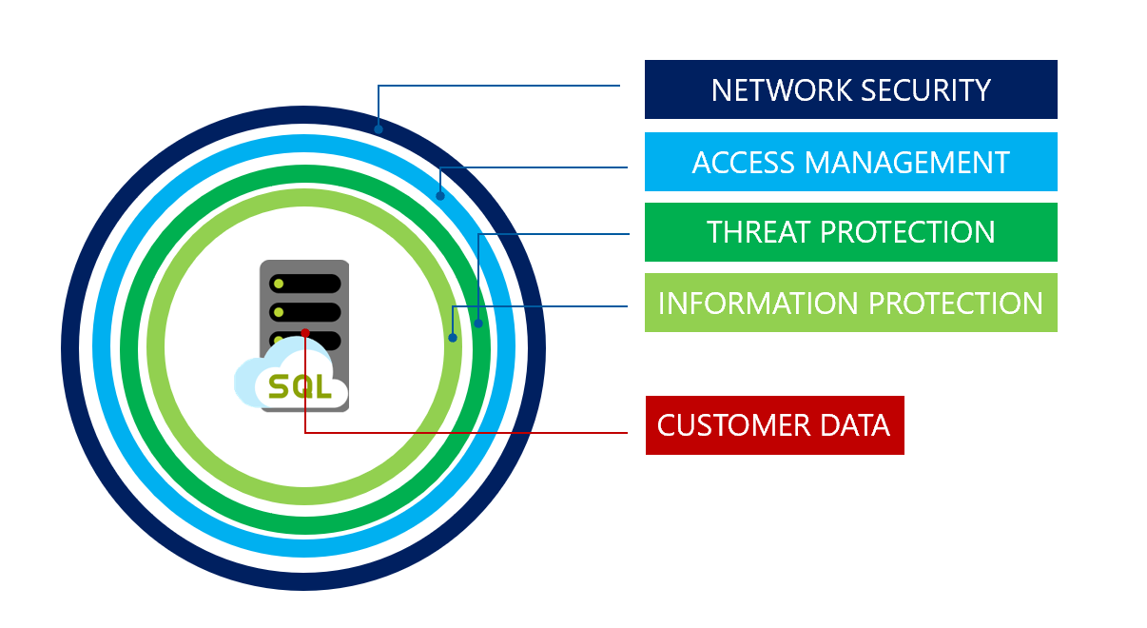
Security in Azure

Slide 6
Security Concepts
Network Security
Identity and Access management
Data protection
Threat protection
Data Governance

Slide 7
Network Security

Slide 8
Allow Access to Azure Services | Firewall rules | Virtual network rules | Private link
Least secure | Secure with firewall | Private IP address of the Azure VM | Most secure
Anything in Azure can connect | Services with added Firewall rules can connect | Any resource in that VN can access Azure SQL | Block all public access
Outside of Azure cannot connect | Allow on-prem connections | Apply virtual network technologies to connect on-prem | Private IP address within a specific virtual network
Public IP address | Public IP address | Private IP address within the VN | Private IP address
DNS hierarchy is public | DNS hierarchy is public (region, cr) | DNS hierarchy is still public (region, cr) | DNS hierarchy shows private endpoint

Slide 9
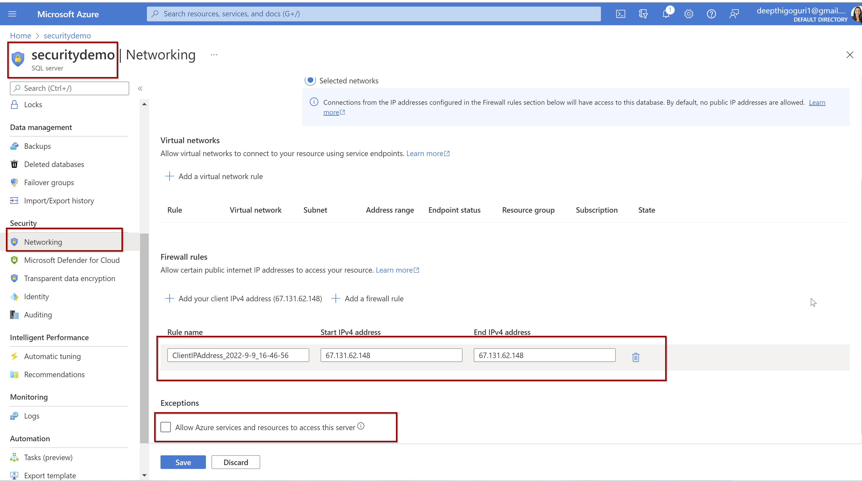
2
1

Slide 10
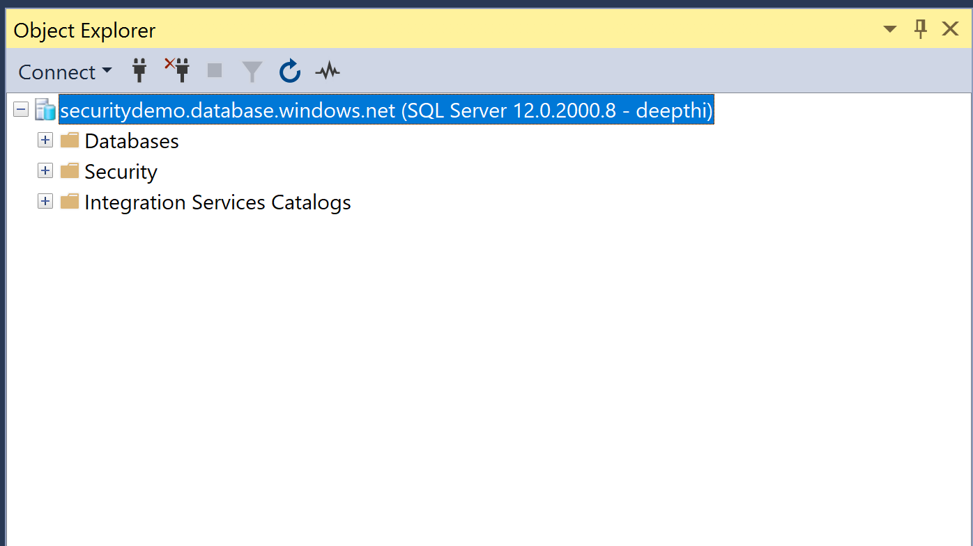

Slide 11
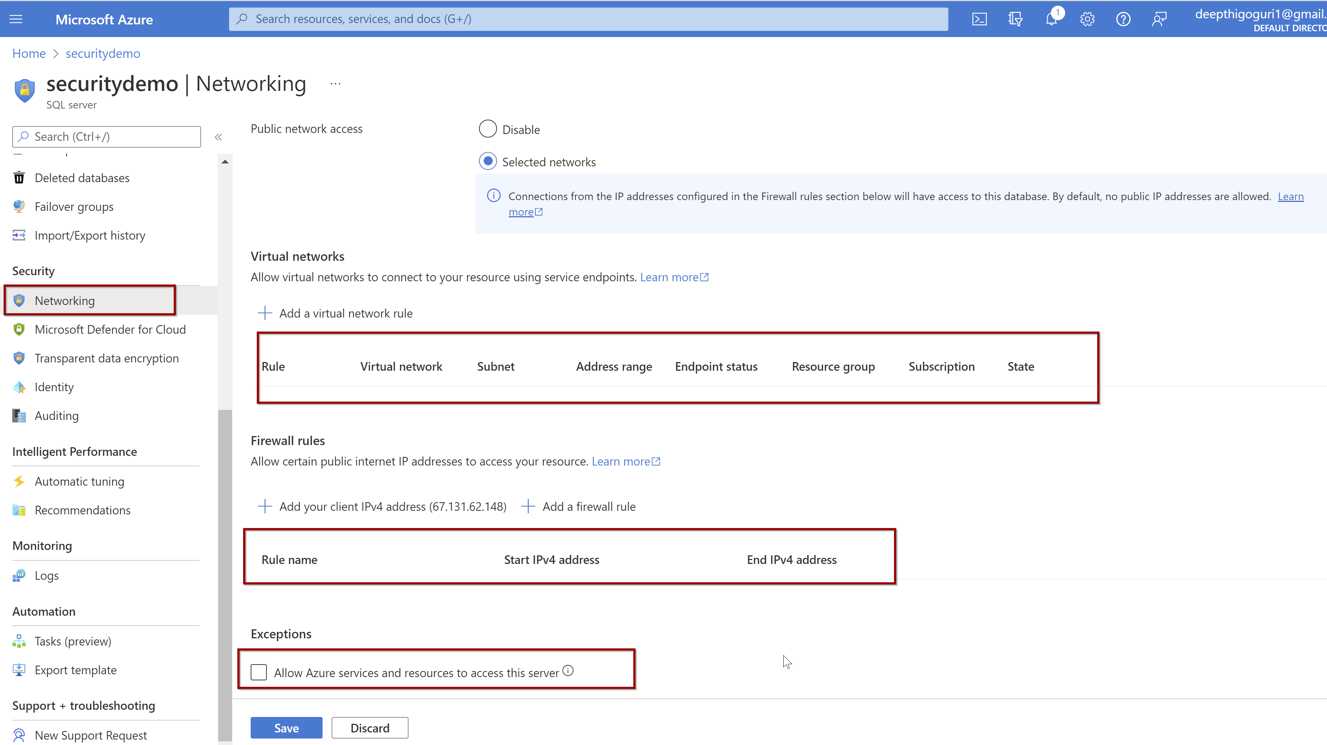

Slide 12
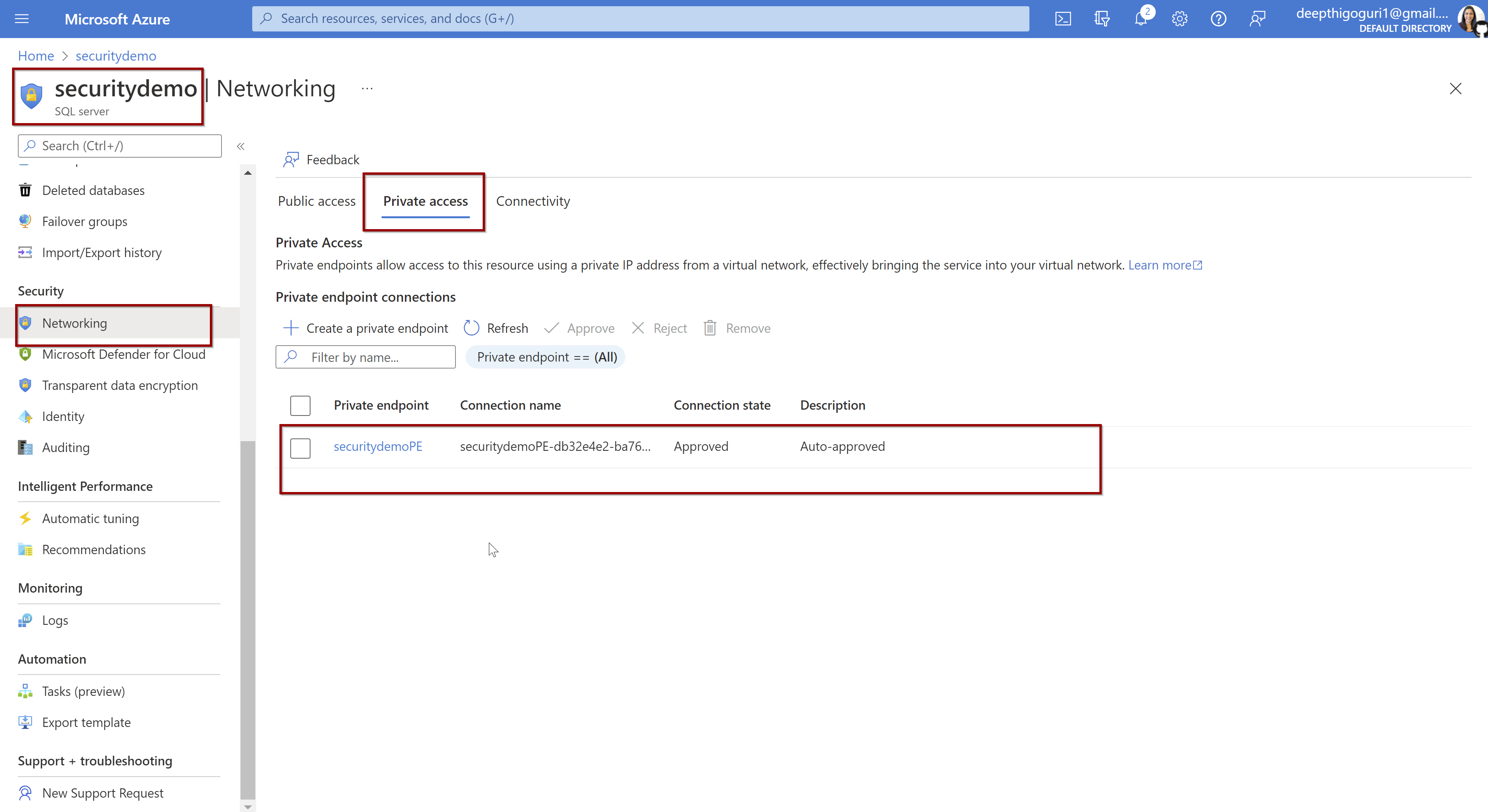

Slide 13
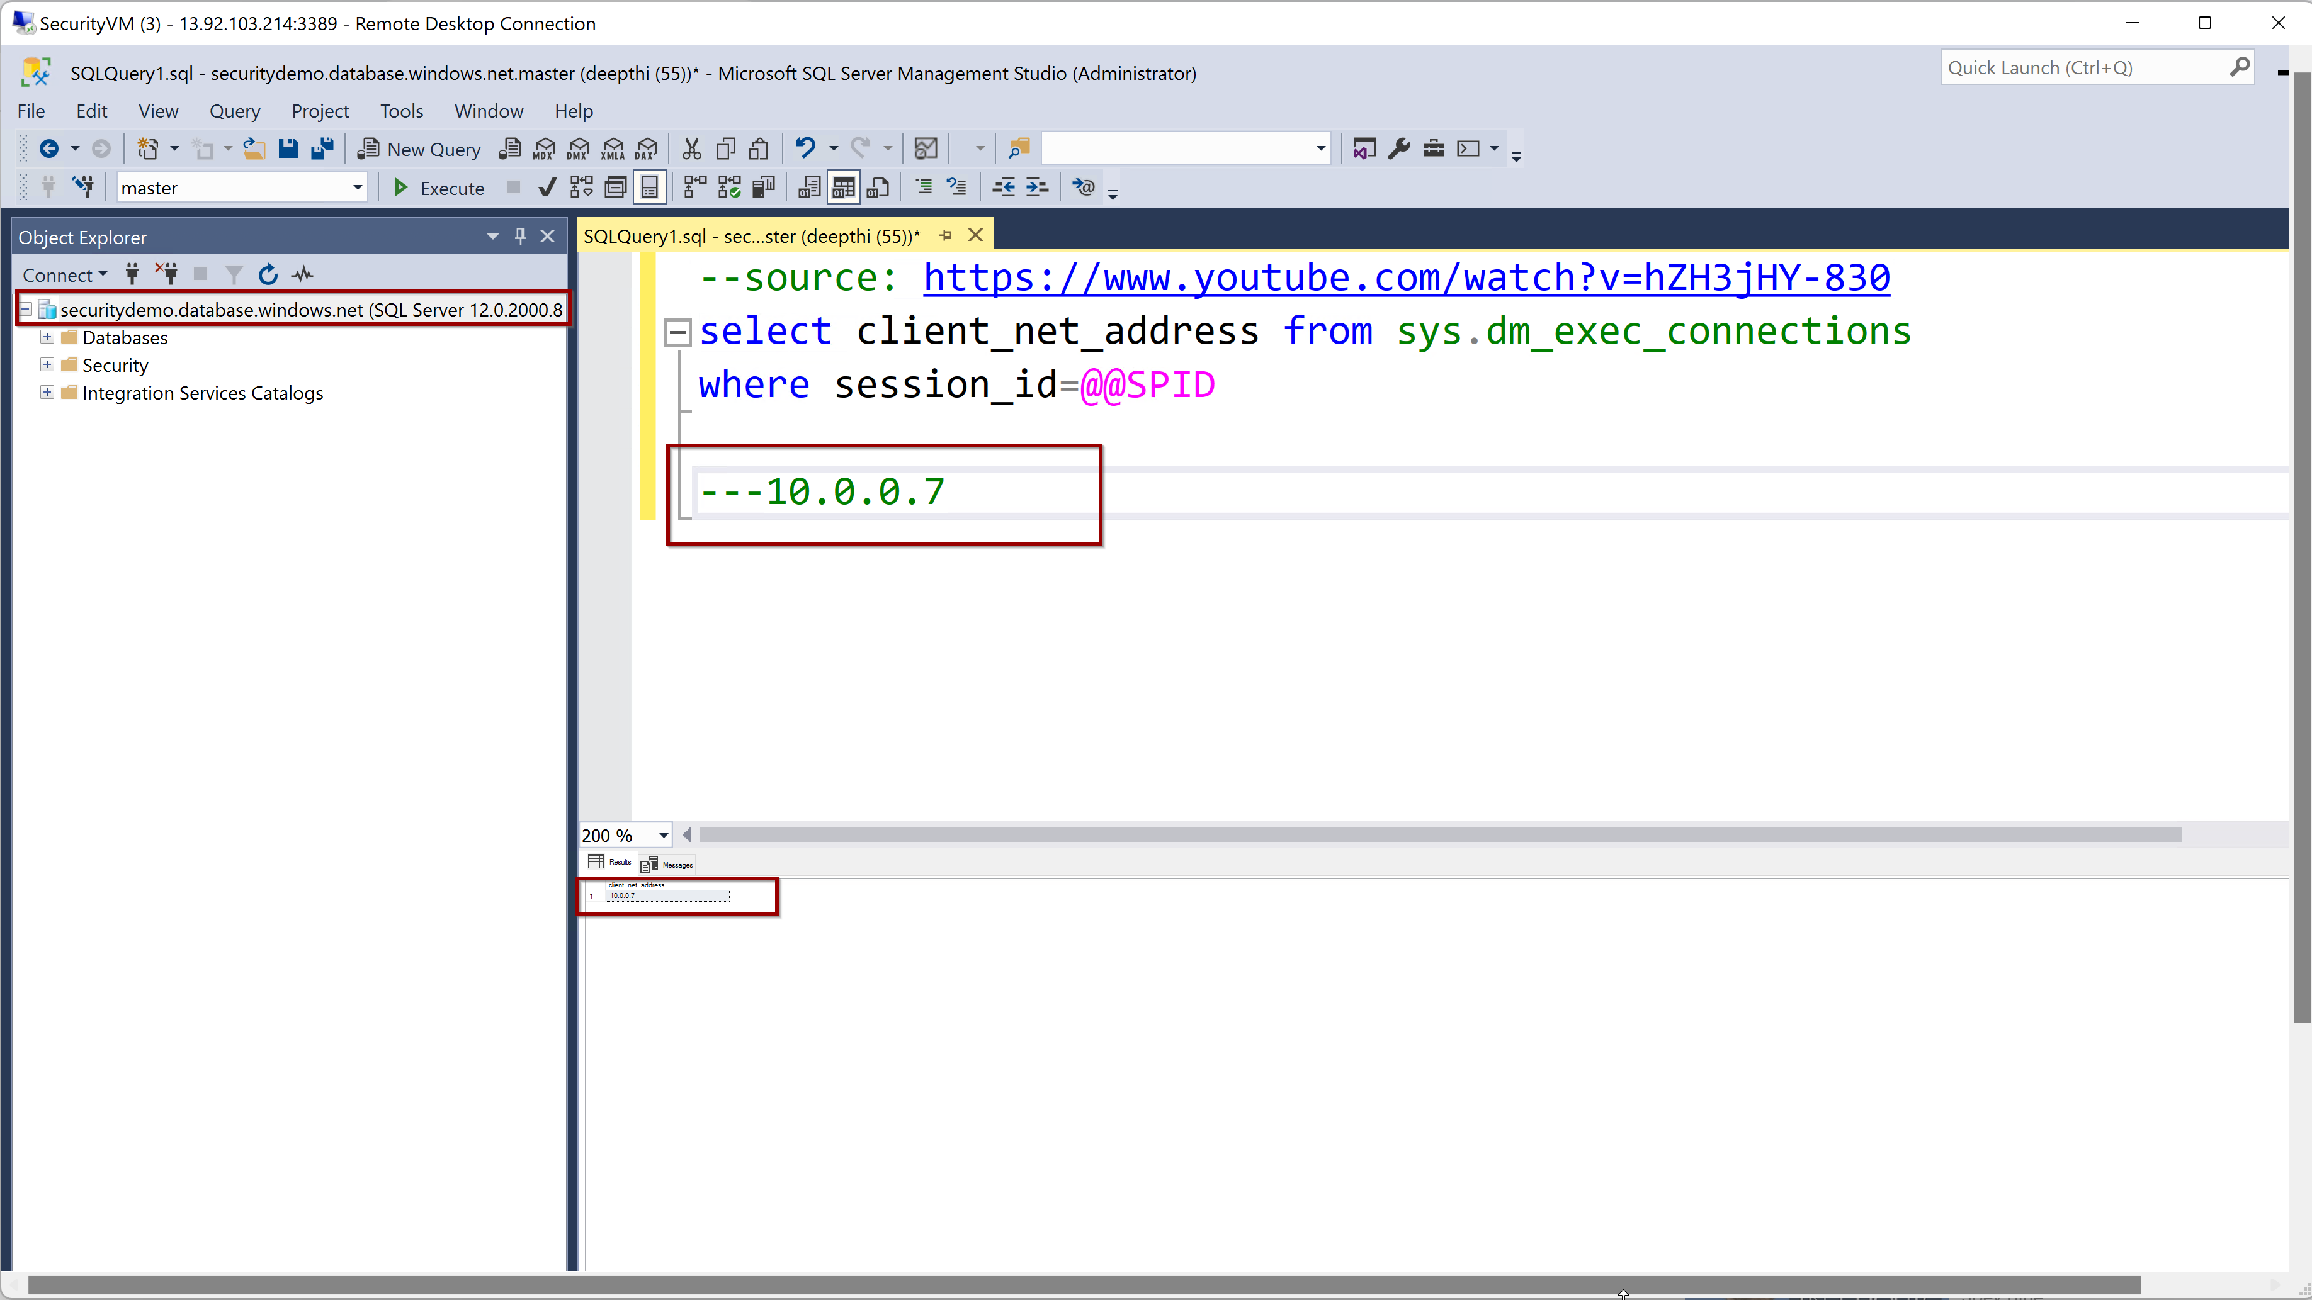

Slide 14
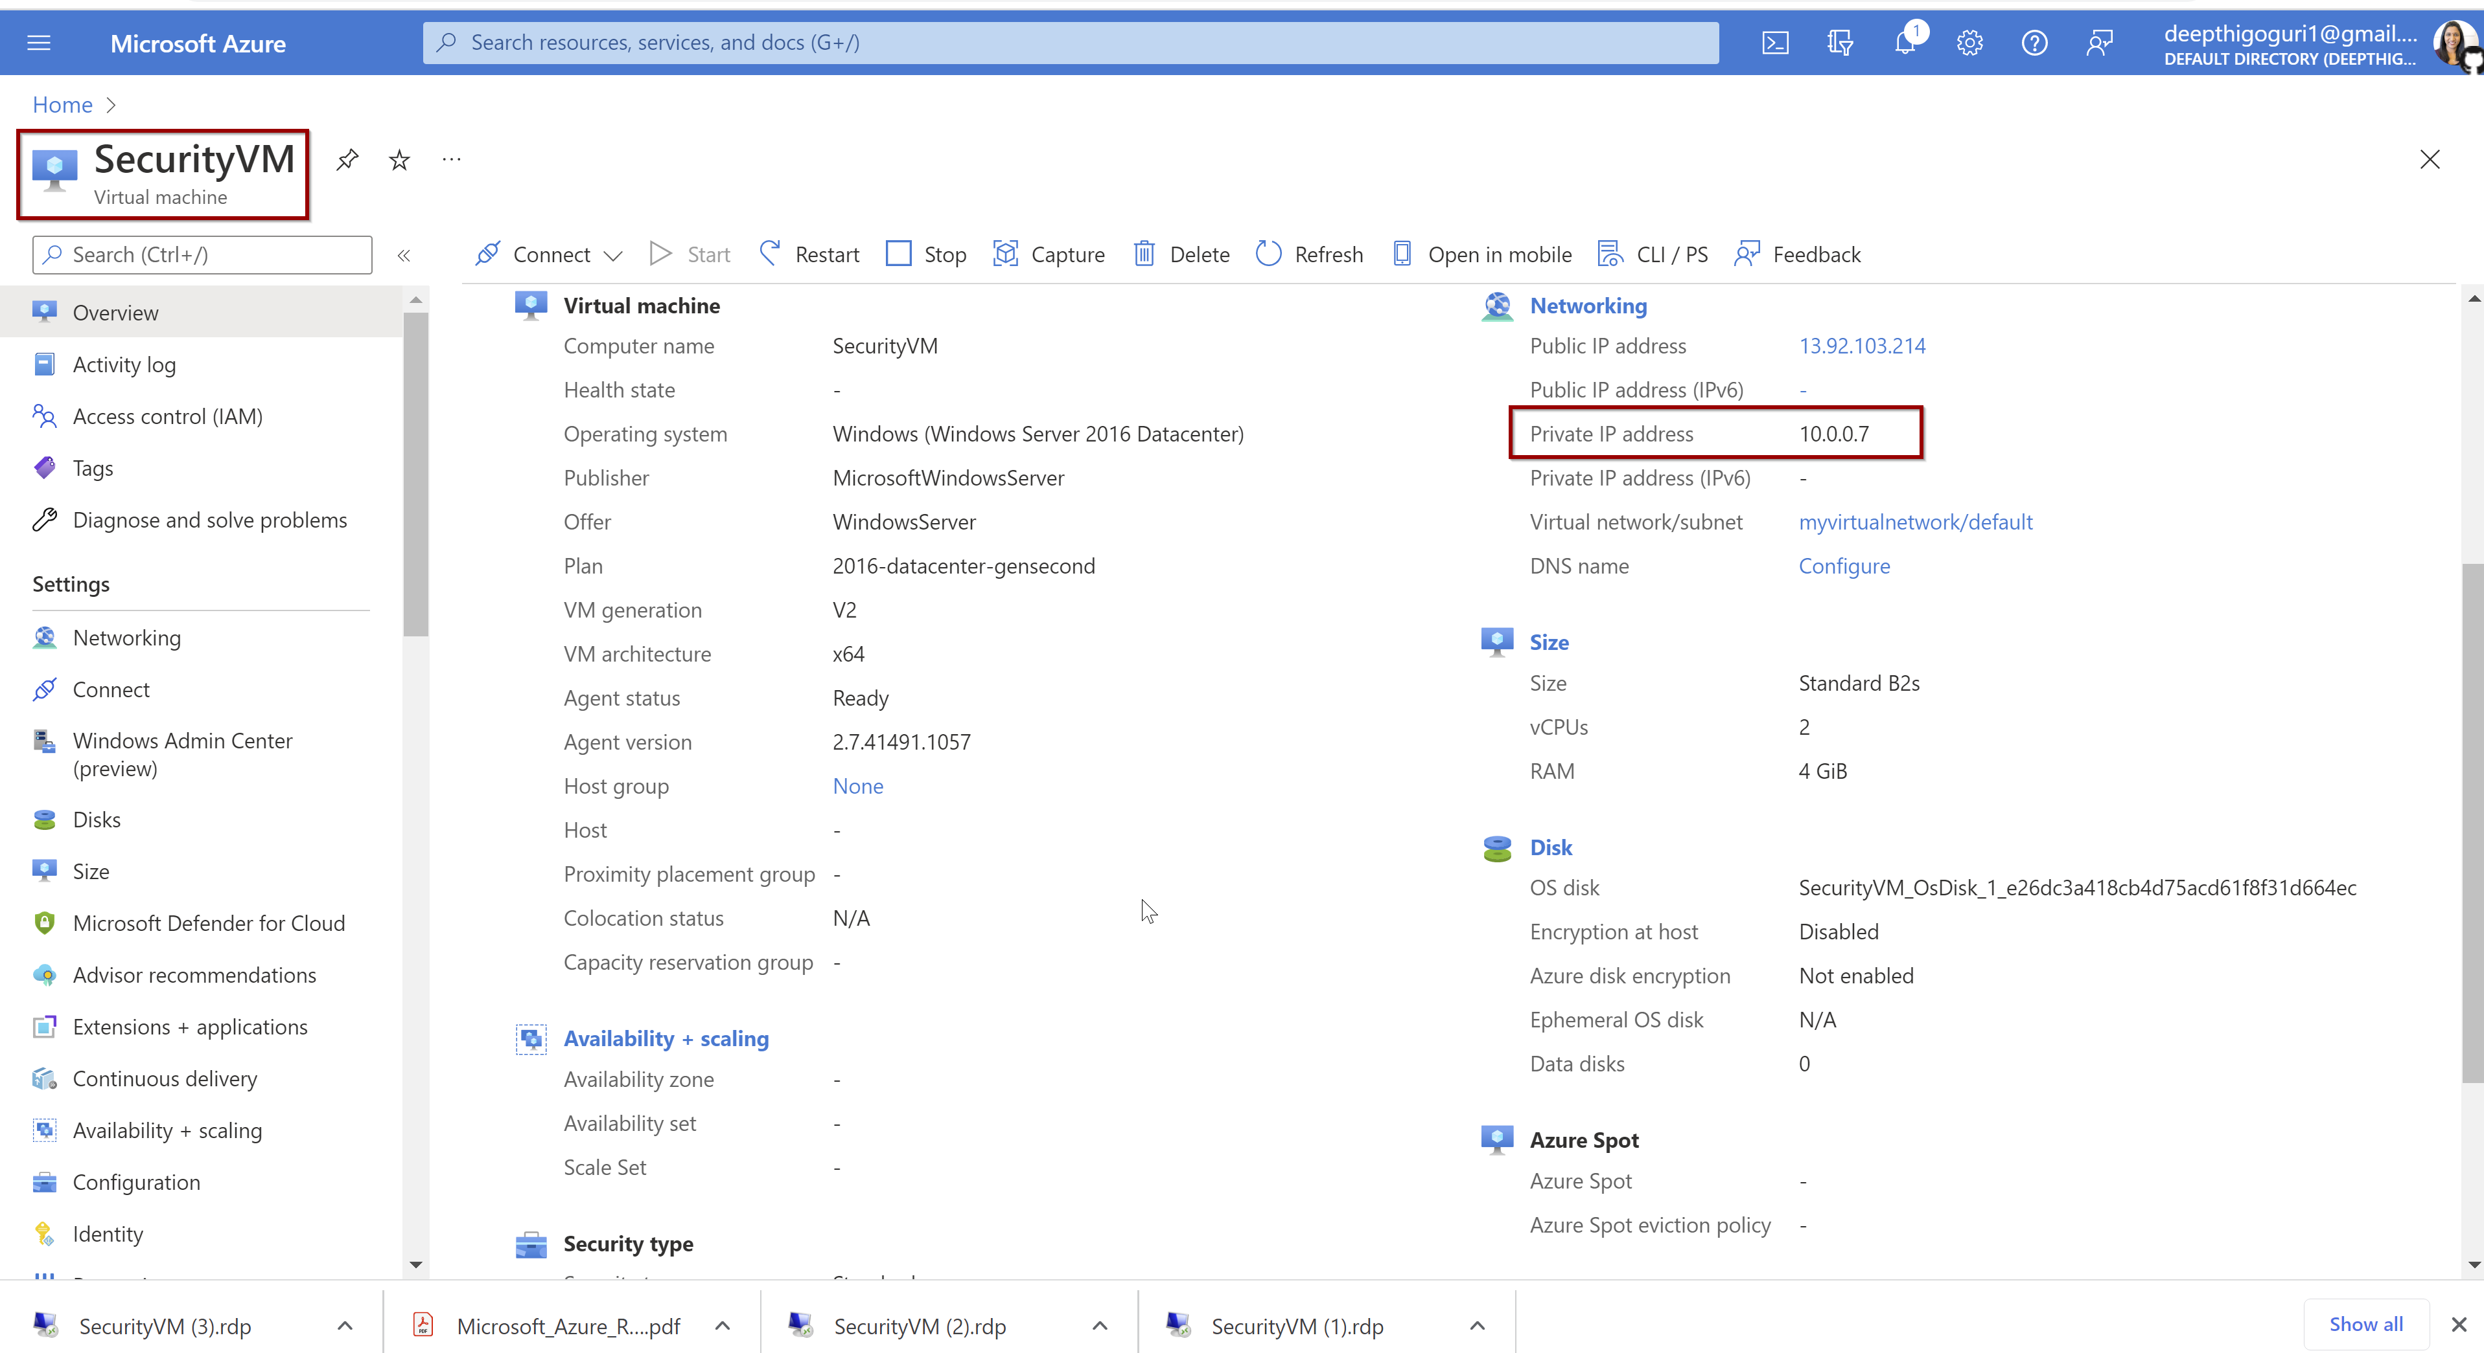

Slide 15
Identity and Access Management

Slide 16
Authentication
Authorization
Proving the user
Both Azure SQL and MI supports
SQL Auth +Azure AD Auth
Azure AD Auth only
MFA
**Server level principle-logical server
**sysadmin server role for MI
Controlling access to resources
Both Azure SQL and MI supports
Database roles
Custom roles
Row-level security (principle of least privilege

Slide 17
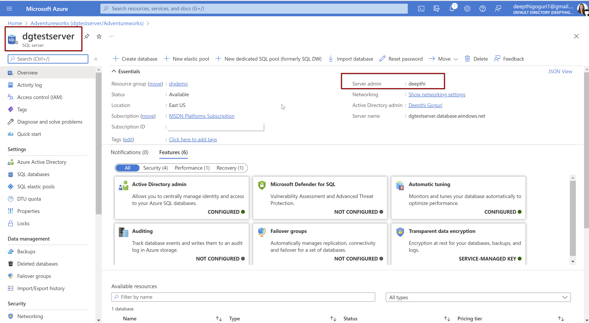

Slide 18
RBAC
⋆ What can and cannot be done to the resources?
⋆ Owner - I can do everything (read, modify and assign)
⋆ Contributor - I can read and modify but not assign
⋆ Reader - I can only read
⋆ Permissions to subscriptions, resource groups and resources. Can be inherited.

Slide 19
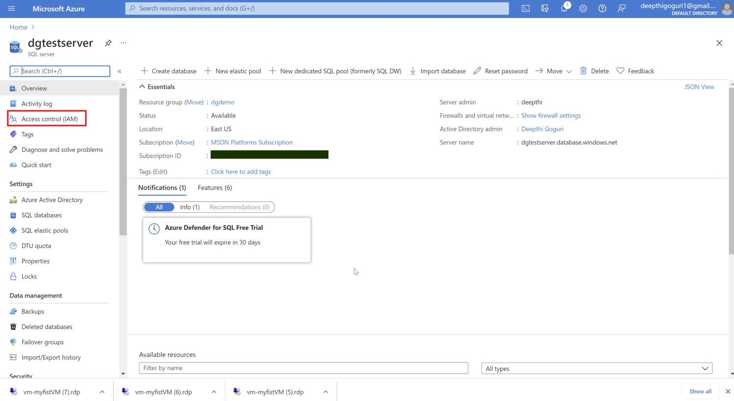

Slide 20
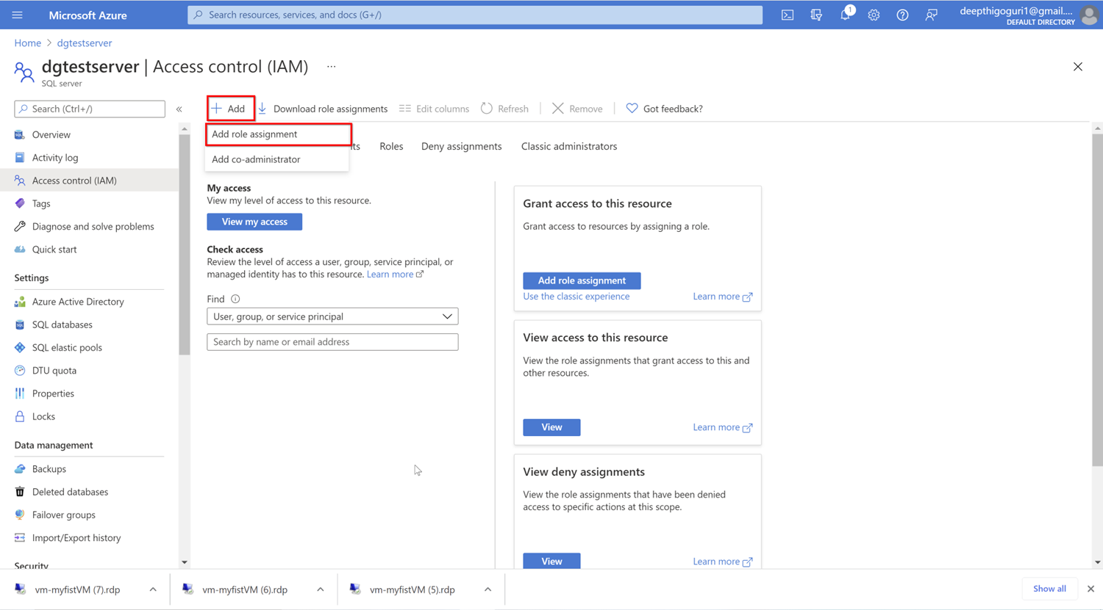

Slide 21
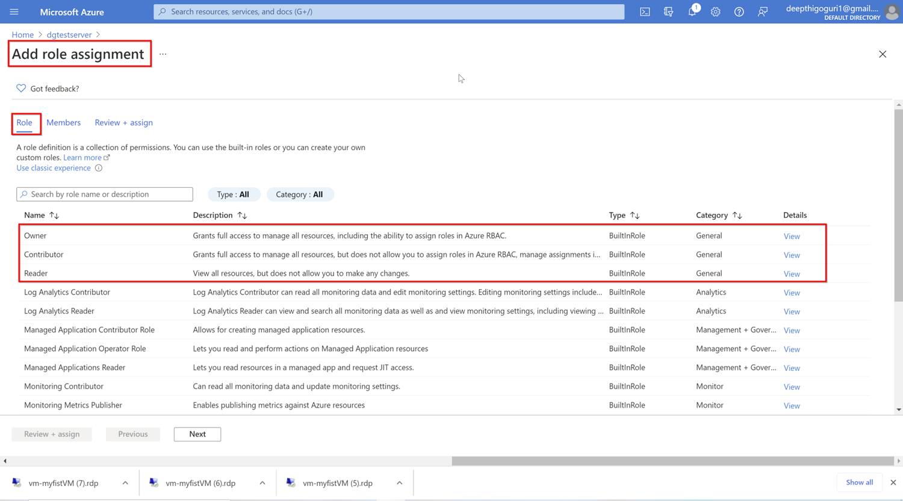

Slide 22
Logins, Users differences..
Managed Instance
Azure SQL DB
Azure AD Server Admin
Azure AD Server Admin
SQL Logins, loginmanager, dbmanager (limited Server admins)
Database Users
SQL or Azure AD Logins
Contained Users
Including AD
Database Users
Contained Users
https://www.youtube.com/watch?v=hZH3jHY-830

Slide 23
Data Encryption

Slide 24
Data Protection
Encryption in-transit
Moving through wire from client application to database
Always encrypted by TLS
Encryption at-rest
Encrypt the inactive data on disk
Always Encrypted by TDE
Encryption in-use
Encrypt data during query processing
Always encrypted
https://www.youtube.com/watch?v=XuoJwjOZPZw&list=PL3EZ3A8mHh0yKcDQHylQfI5BT_mM1KY8Z&index=3

Slide 25
Encryption in-transit
Industry standard protocol- TLS
Enforced all time for all connections
Encrypted connection from applications=ON

Slide 26
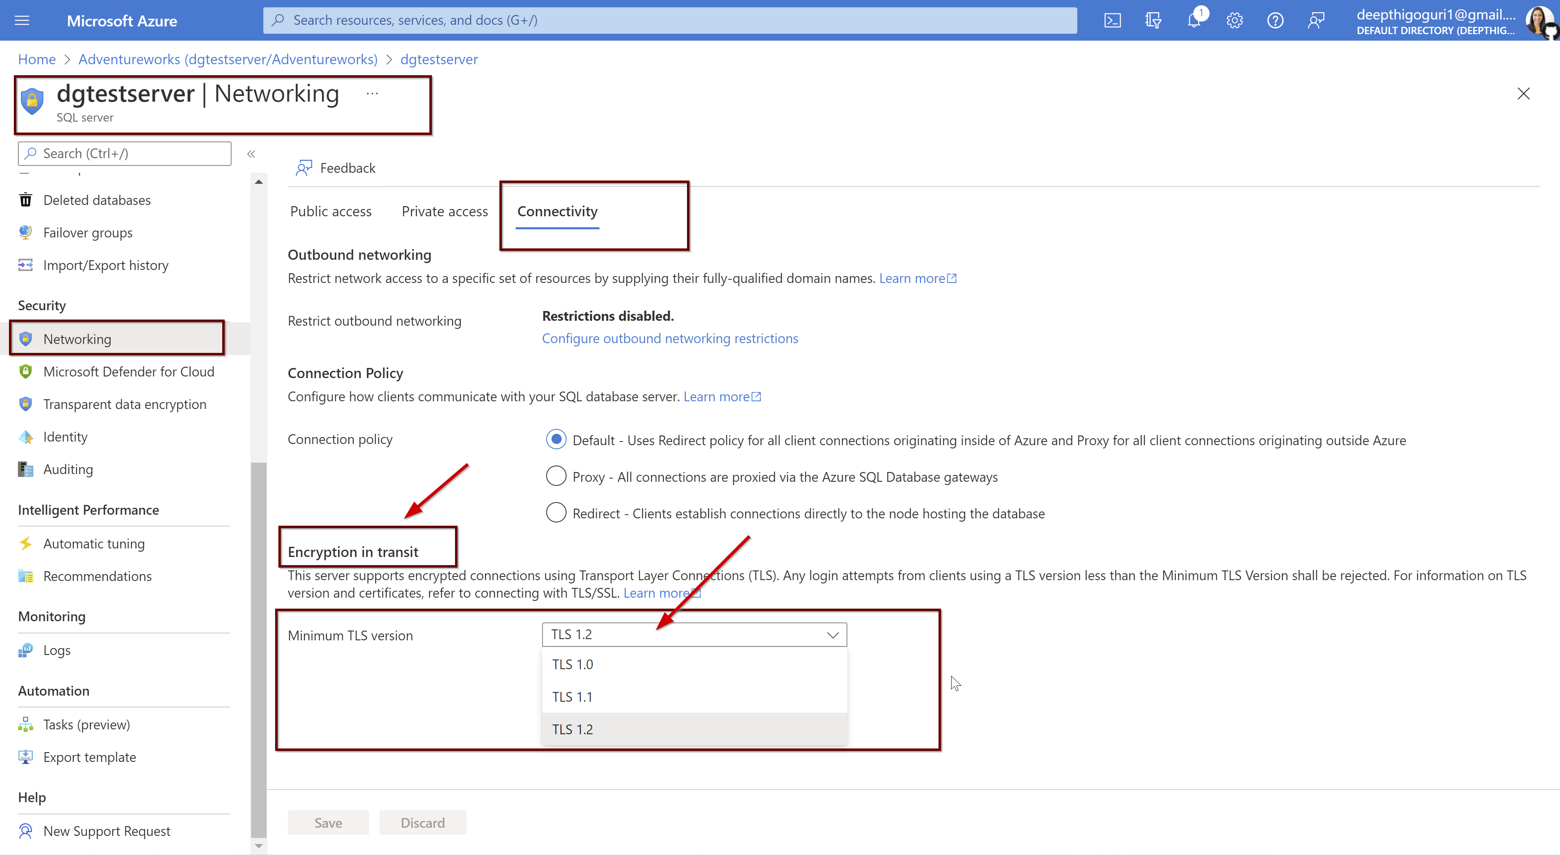

Slide 27
Encryption at-rest
Data inactive on drives
Database files, backup files, log files
Real time encryption and decryption of data
Enabled by default
Microsoft managed key (Default)
BYOK stored in Key vault (Key generation, rotation, access, IaaS)

Slide 28
HYOK (Key operations, key management, HSM (hardware security module), IaaS)

Slide 29
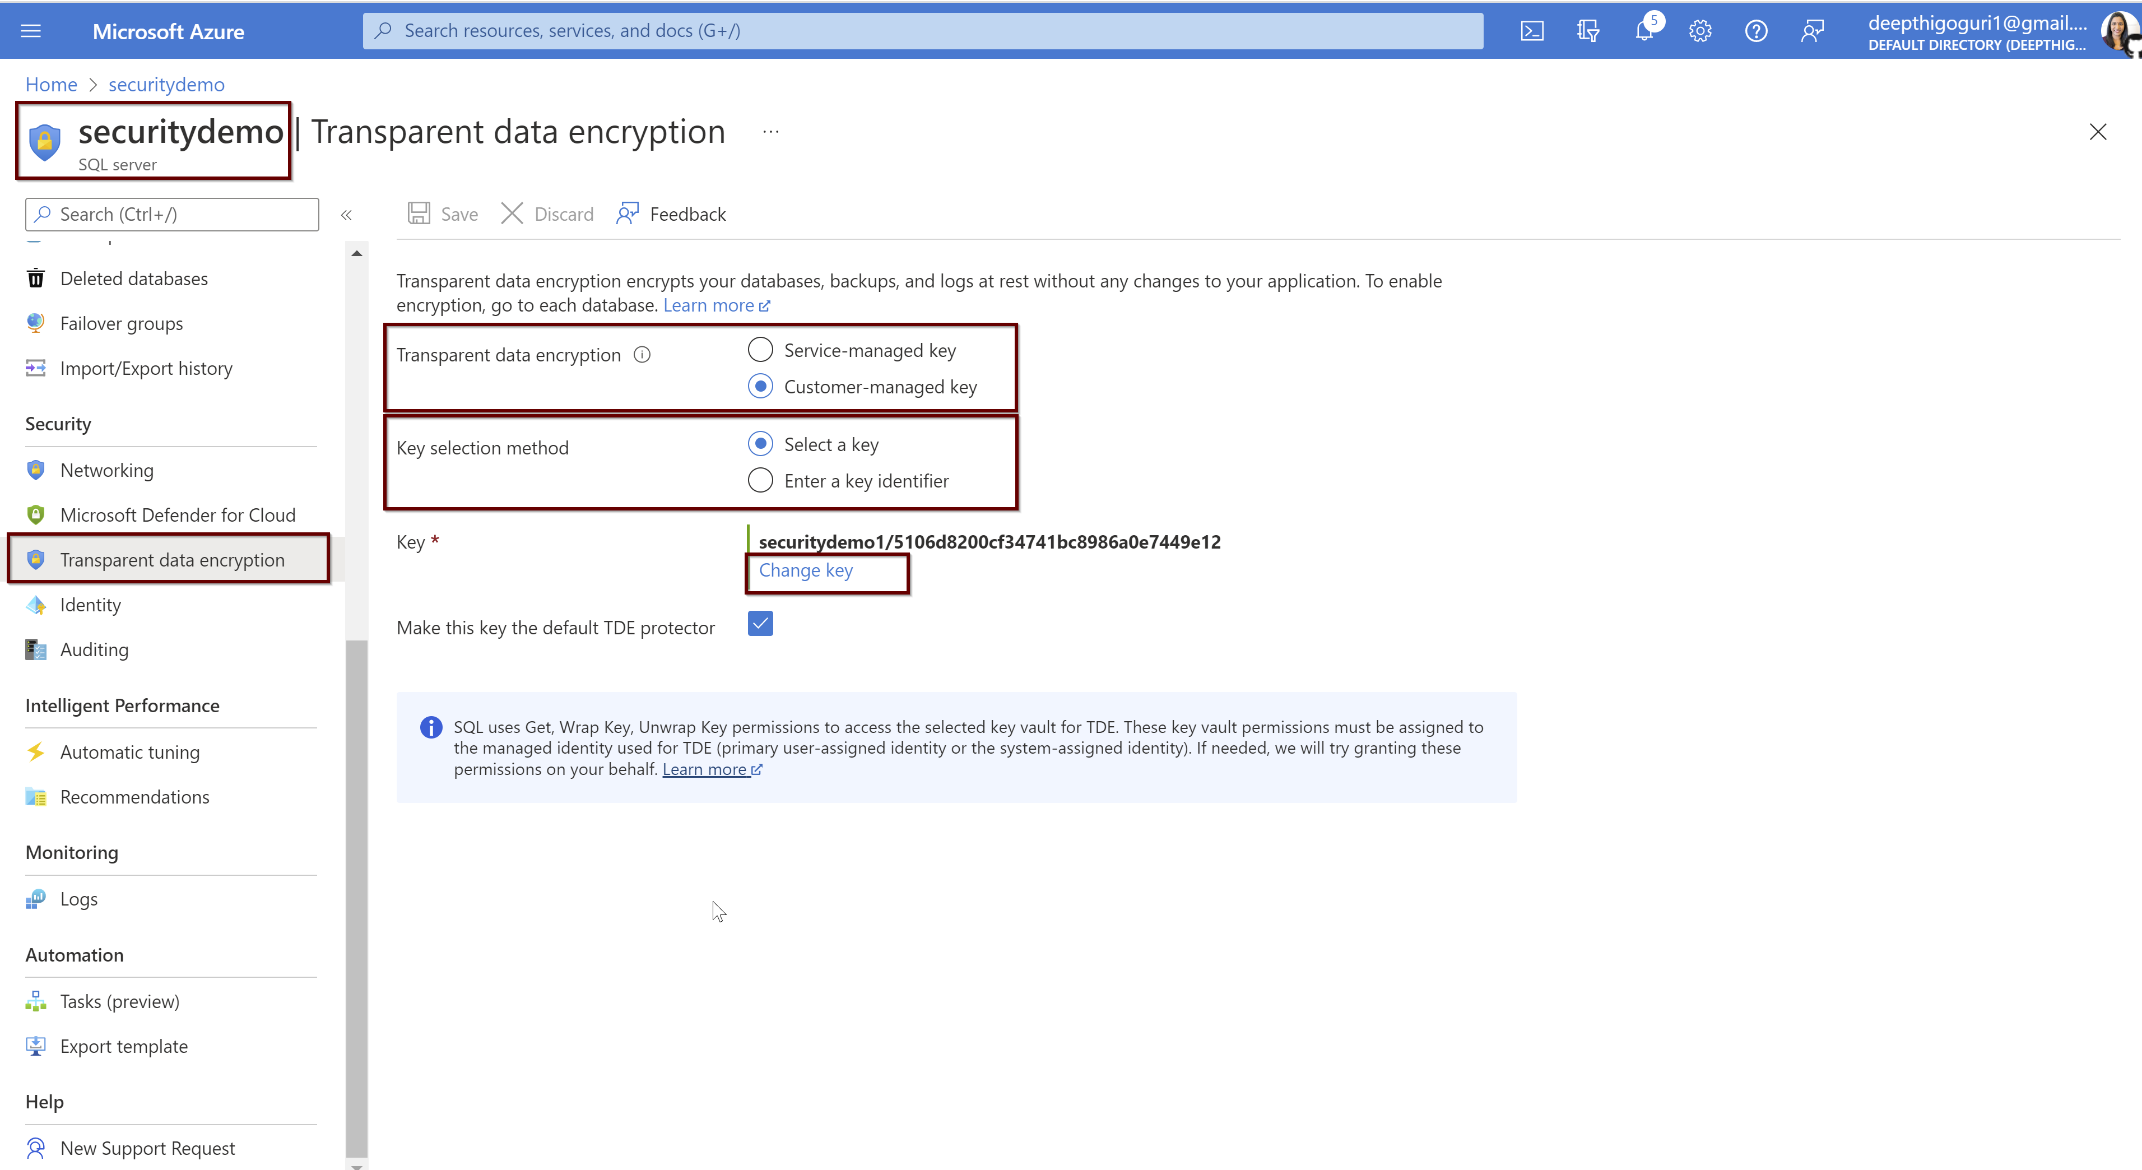

Slide 30
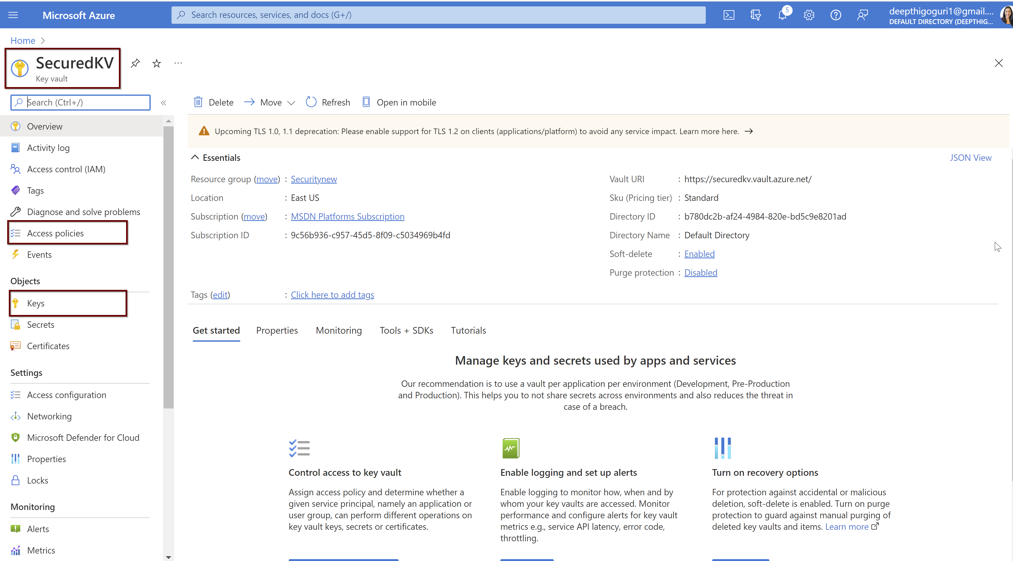

Slide 31
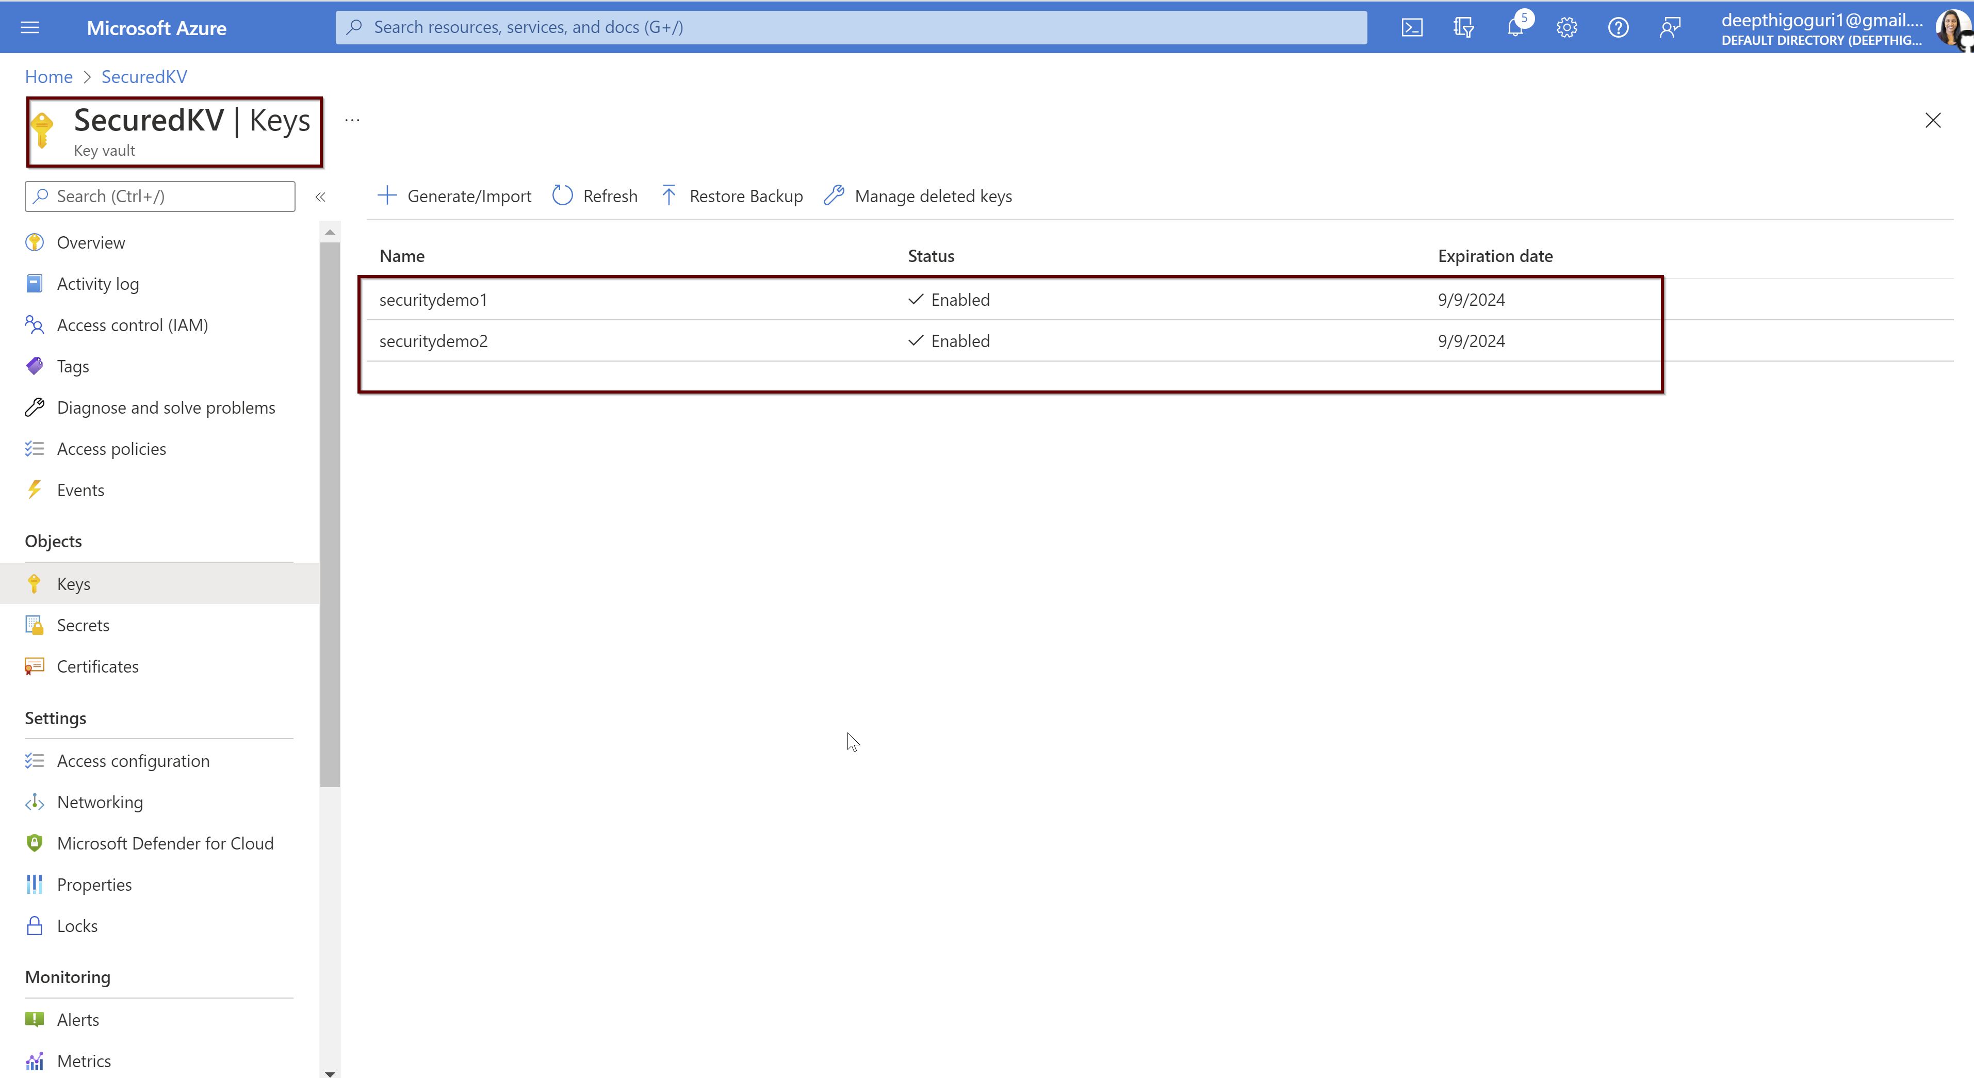

Slide 32
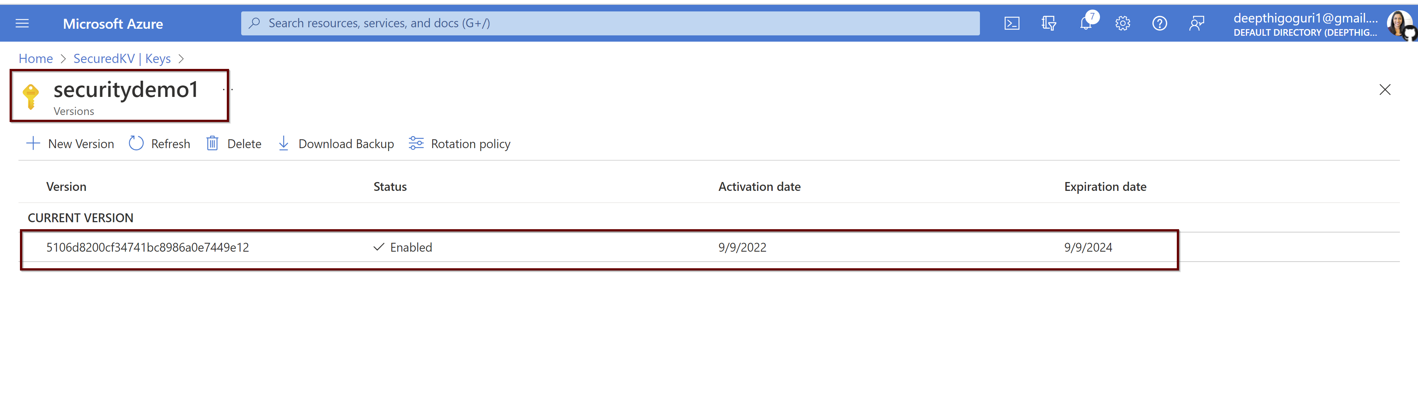

Slide 33
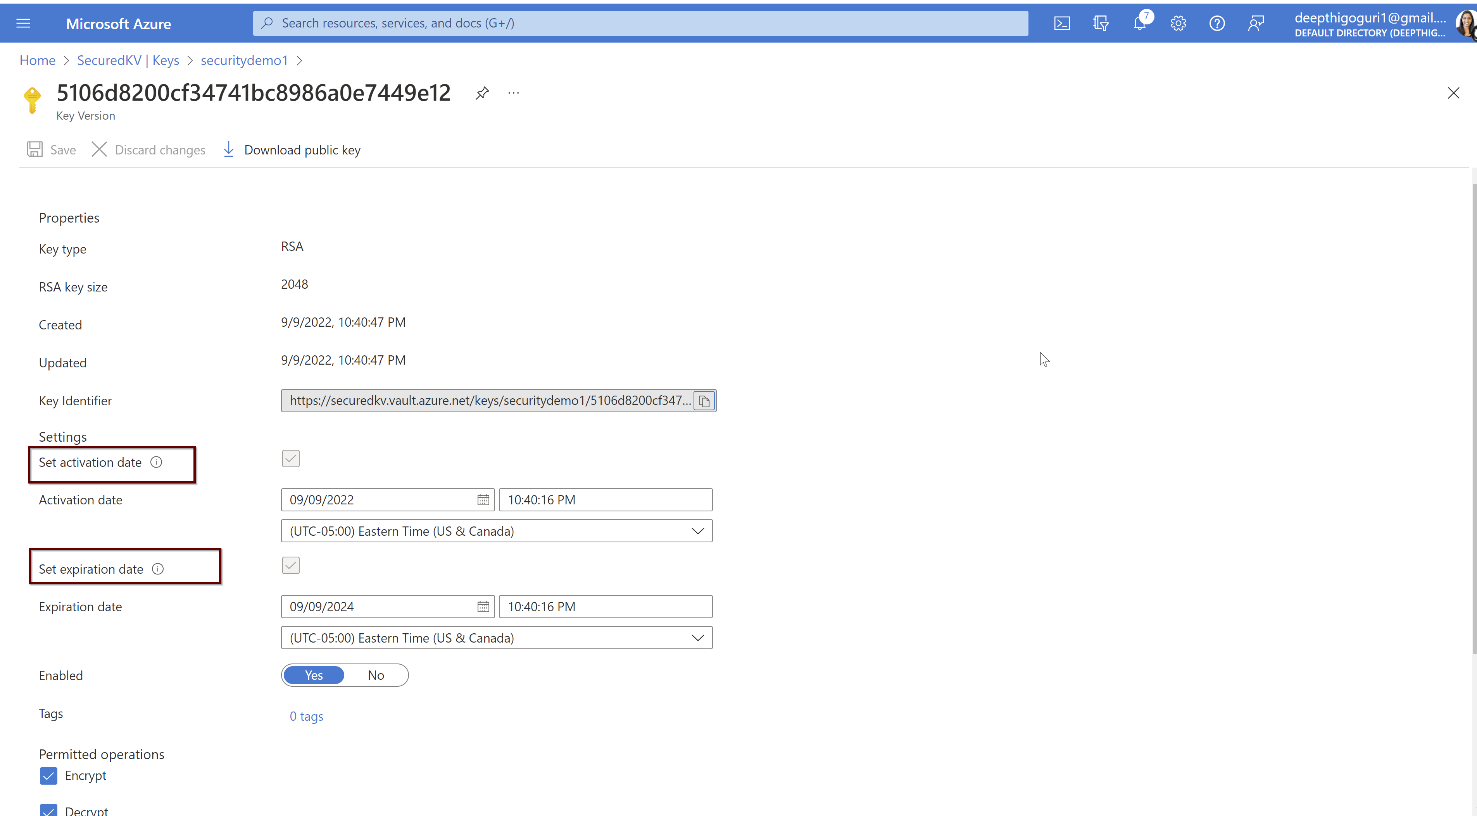

Slide 34
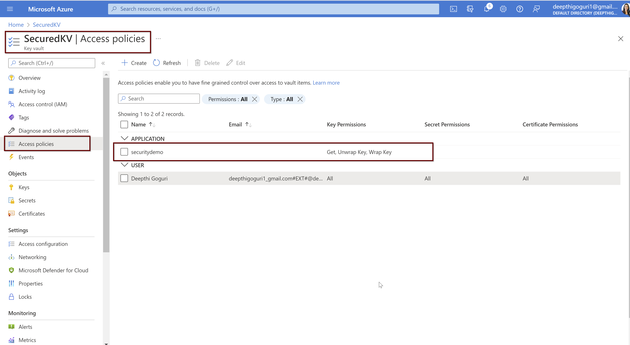

Slide 35
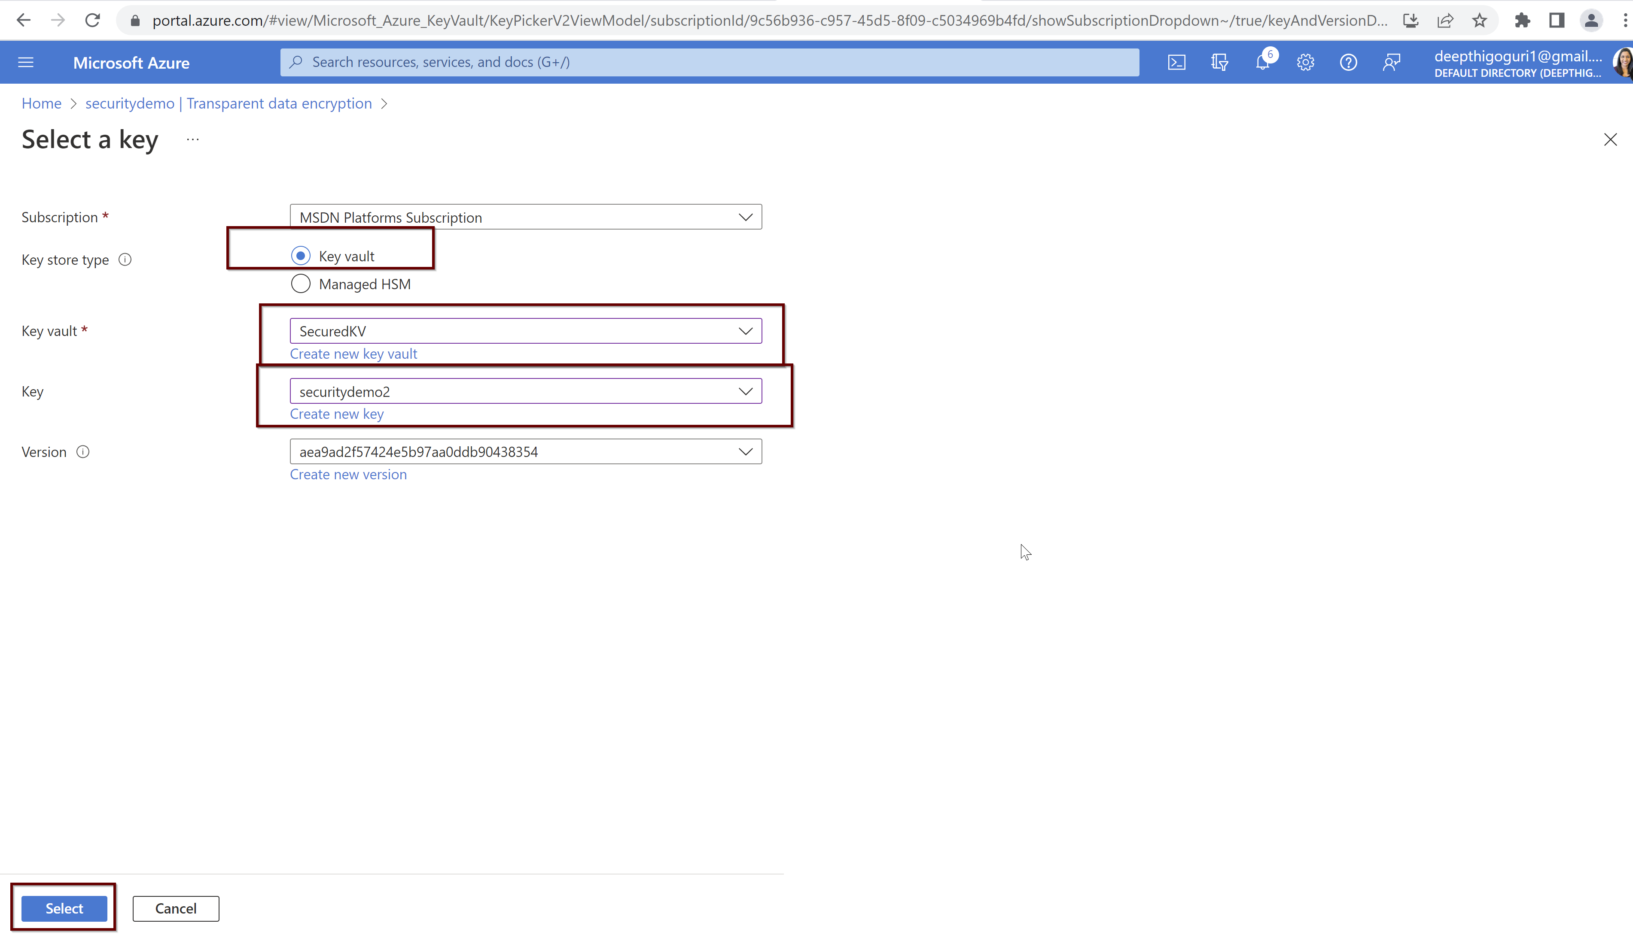

Slide 36
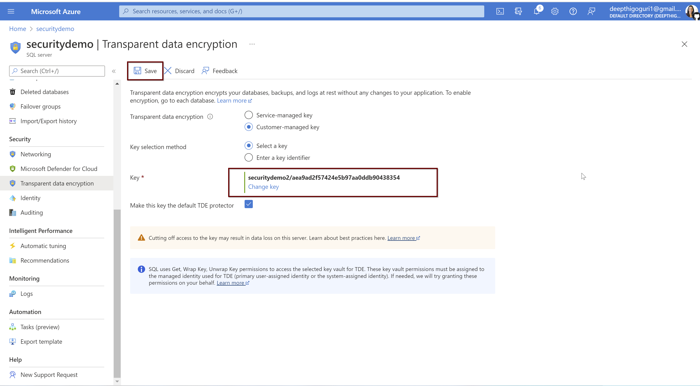

Slide 37
Encryption in-use
Client-side encryption technology
Data gets encrypted, decrypted from client side
From the db side, data is always encrypted
Client driver>encrypts data sent from the application to db
By using the confidential computing for the equality comparisons
For cryptographic operations, trusted machine outside database

Slide 38
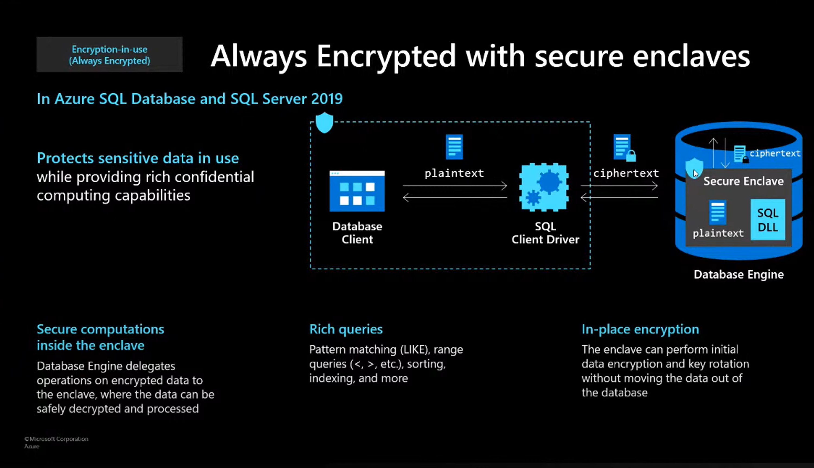
Secure enclaves

Slide 39
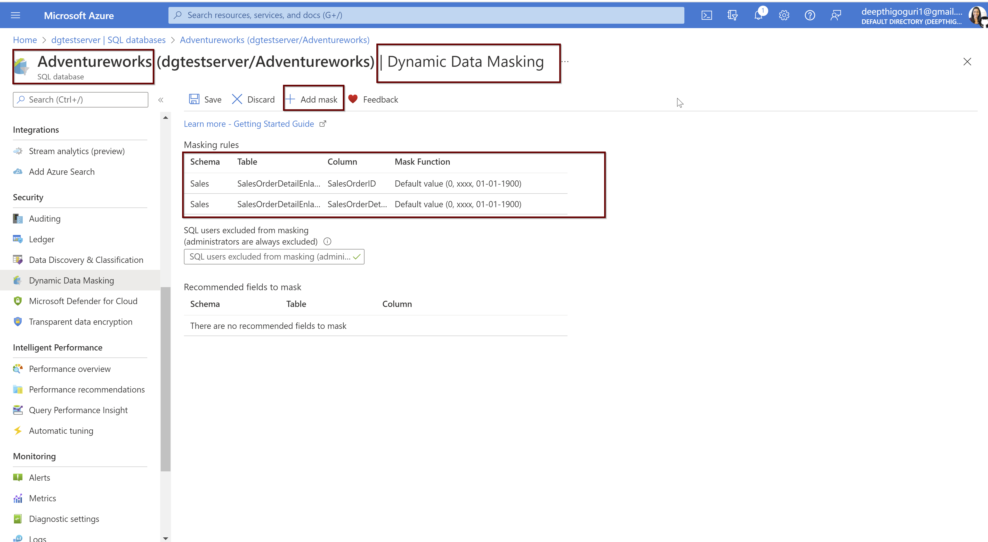
Dynamic Data Masking

Slide 40
Threat Protection and Detection

Slide 41
Threat protection
Azure defender - SQL Vulnerability Assessment
Azure defender – SQL Threat detection
SQL Auditing
Azure Security Center

Slide 42
Azure defender

Slide 43
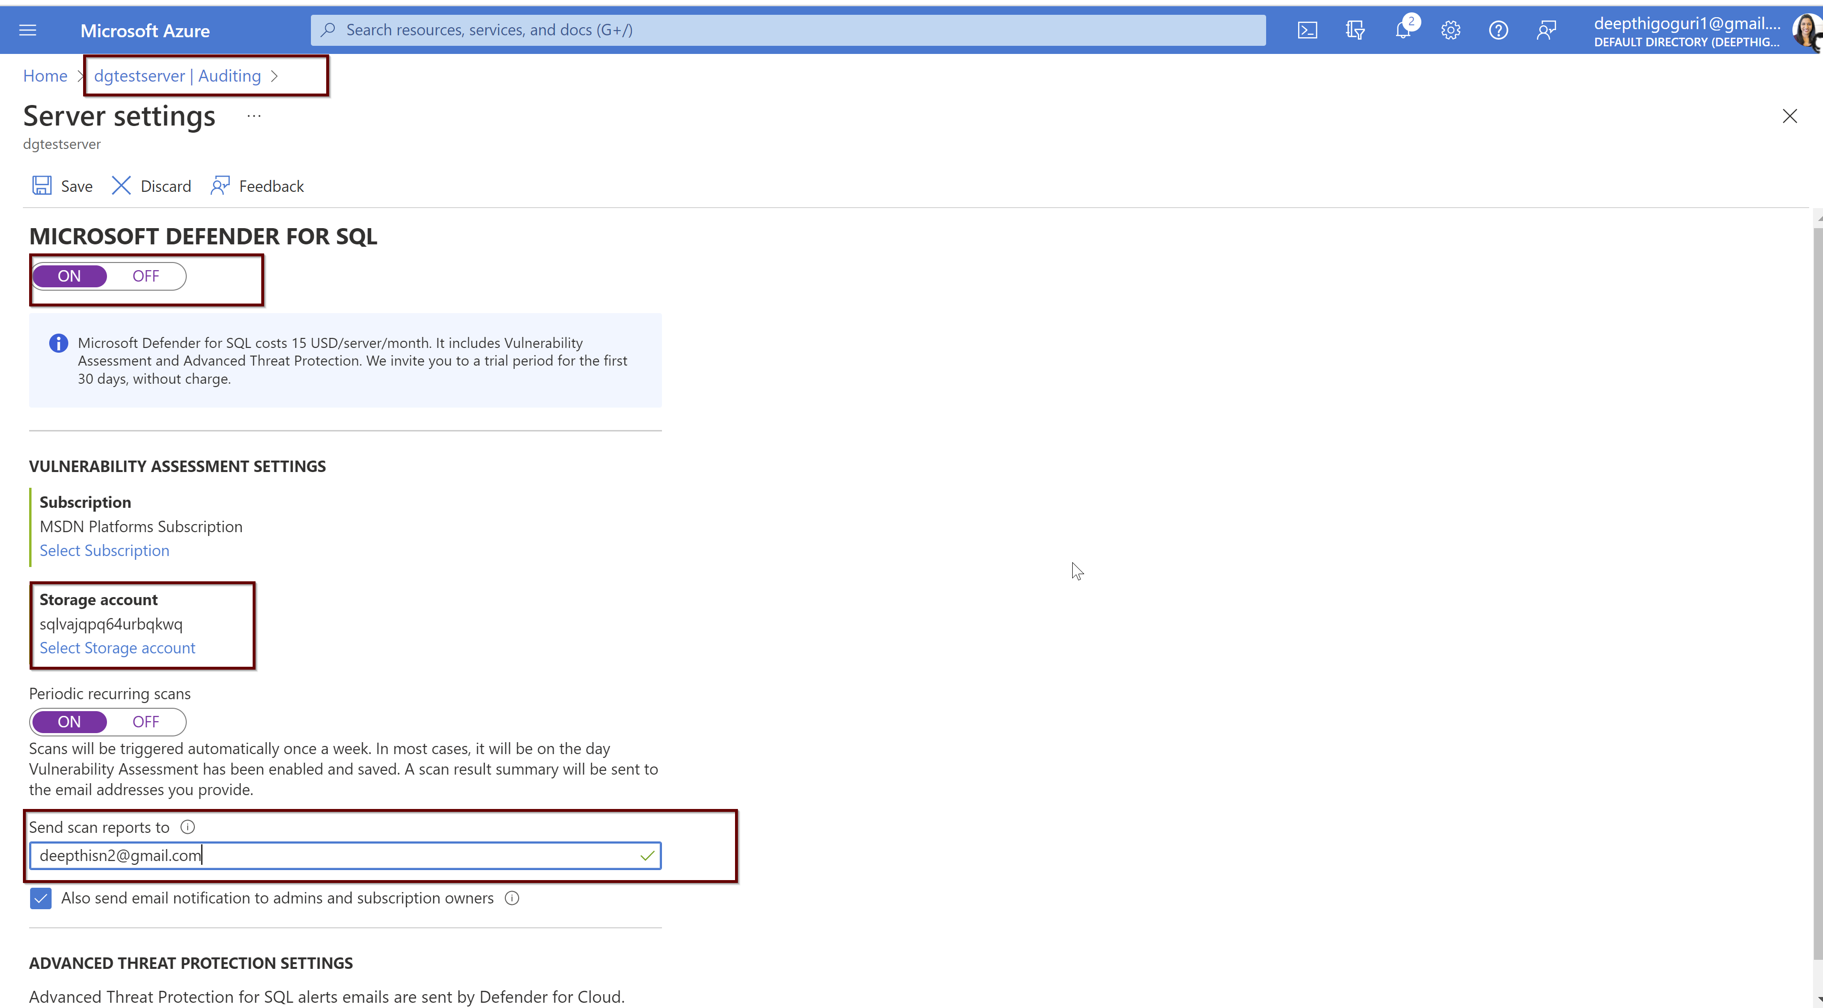

Slide 44
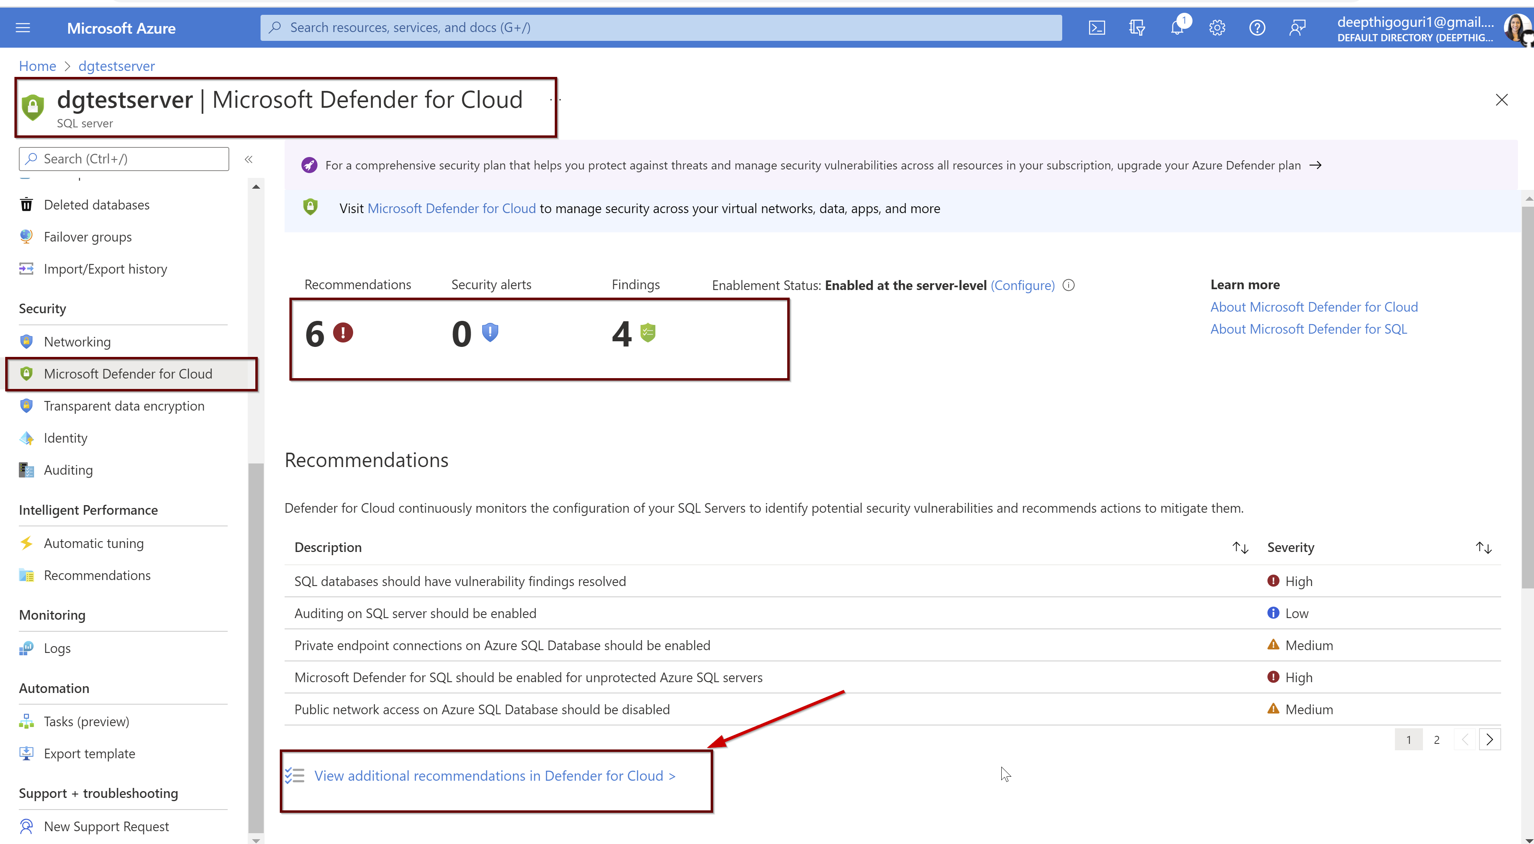

Slide 45
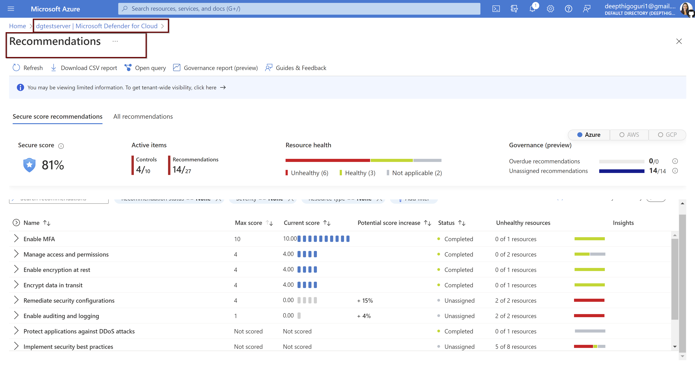

Slide 46
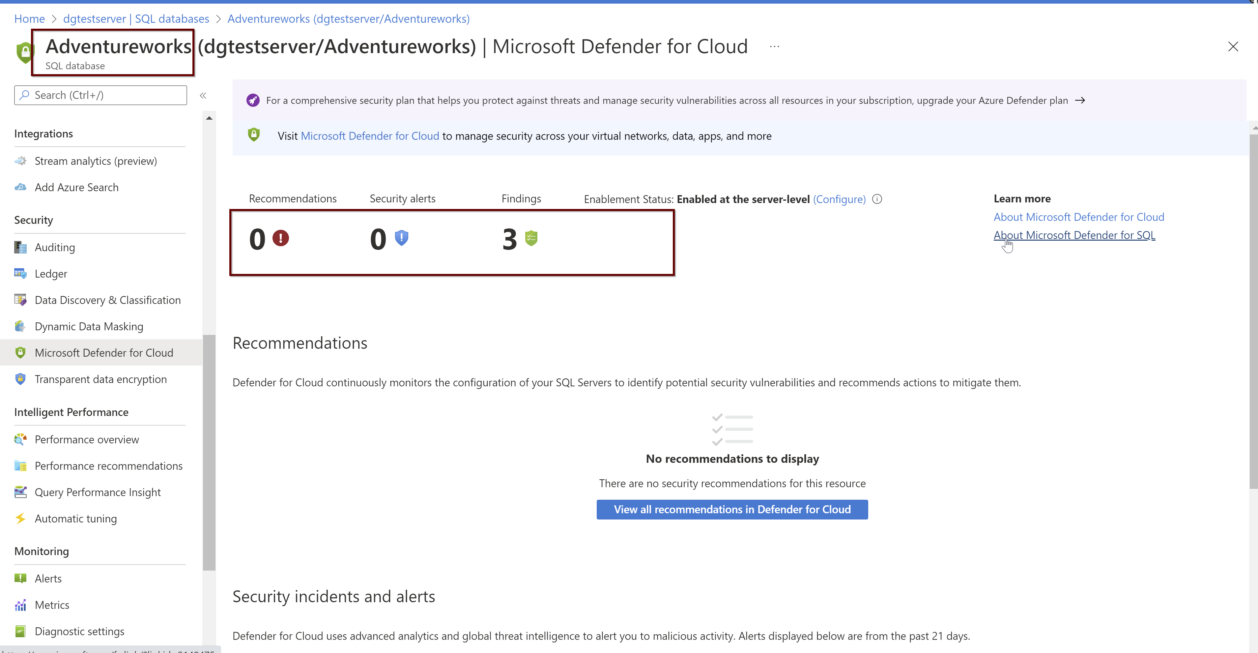

Slide 47
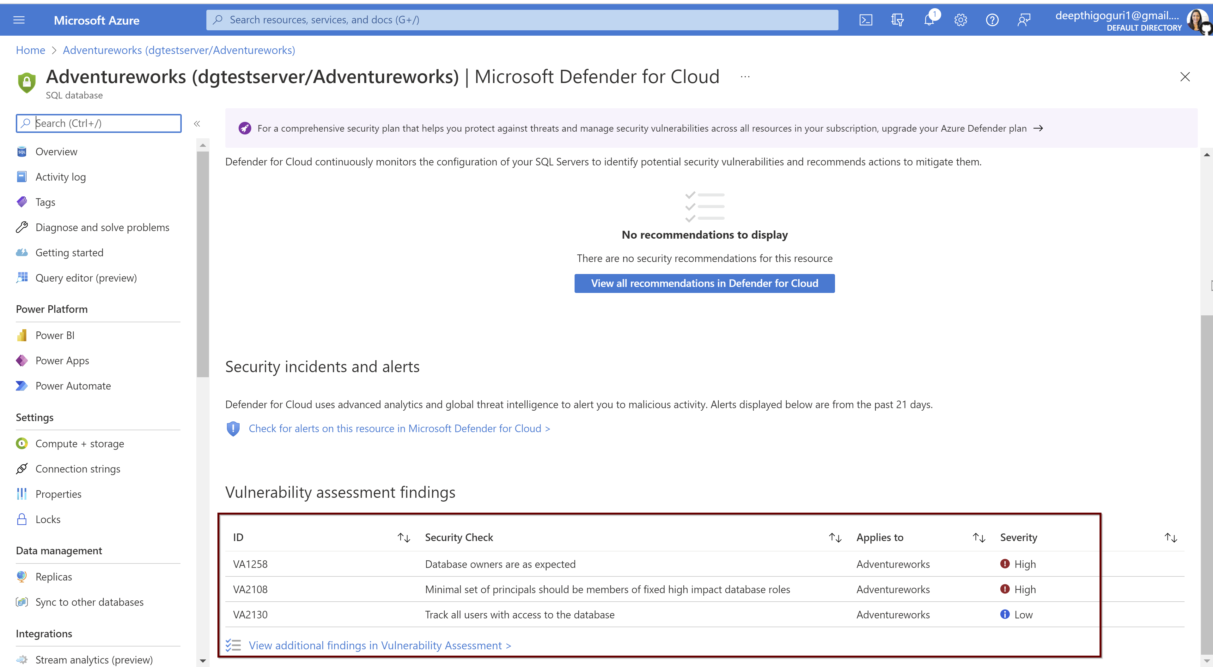

Slide 48
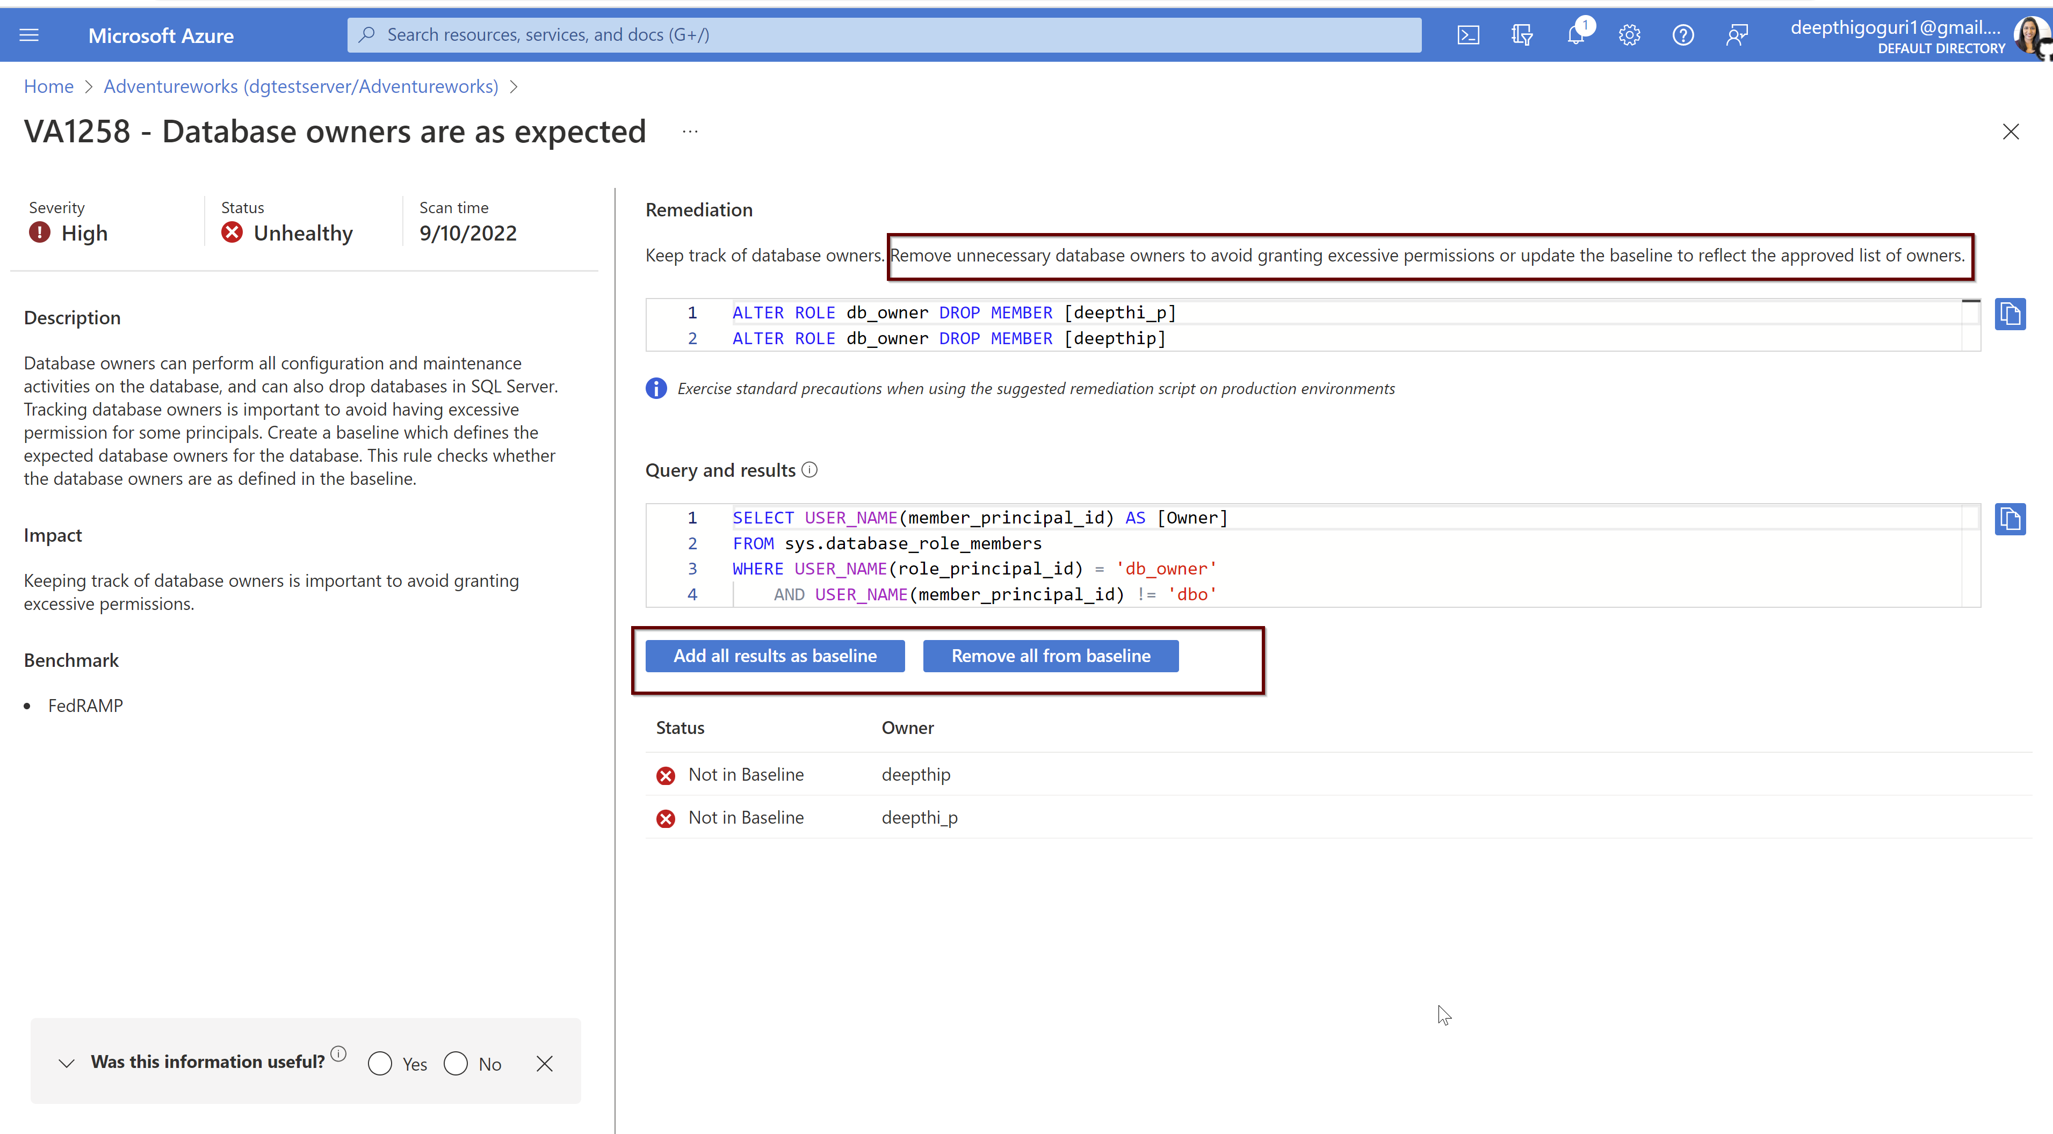

Slide 49
Auditing

Slide 50
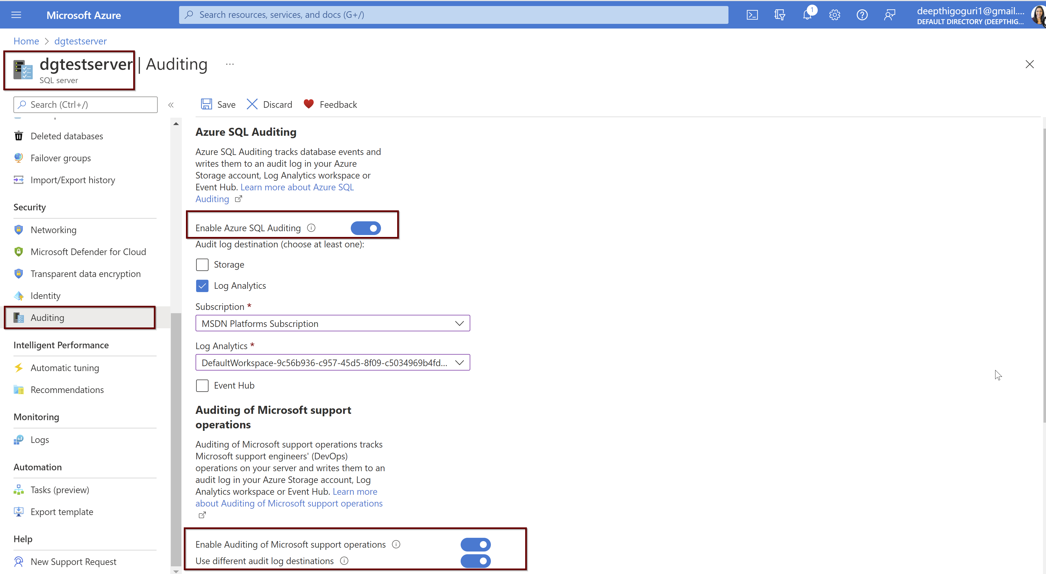

Slide 51
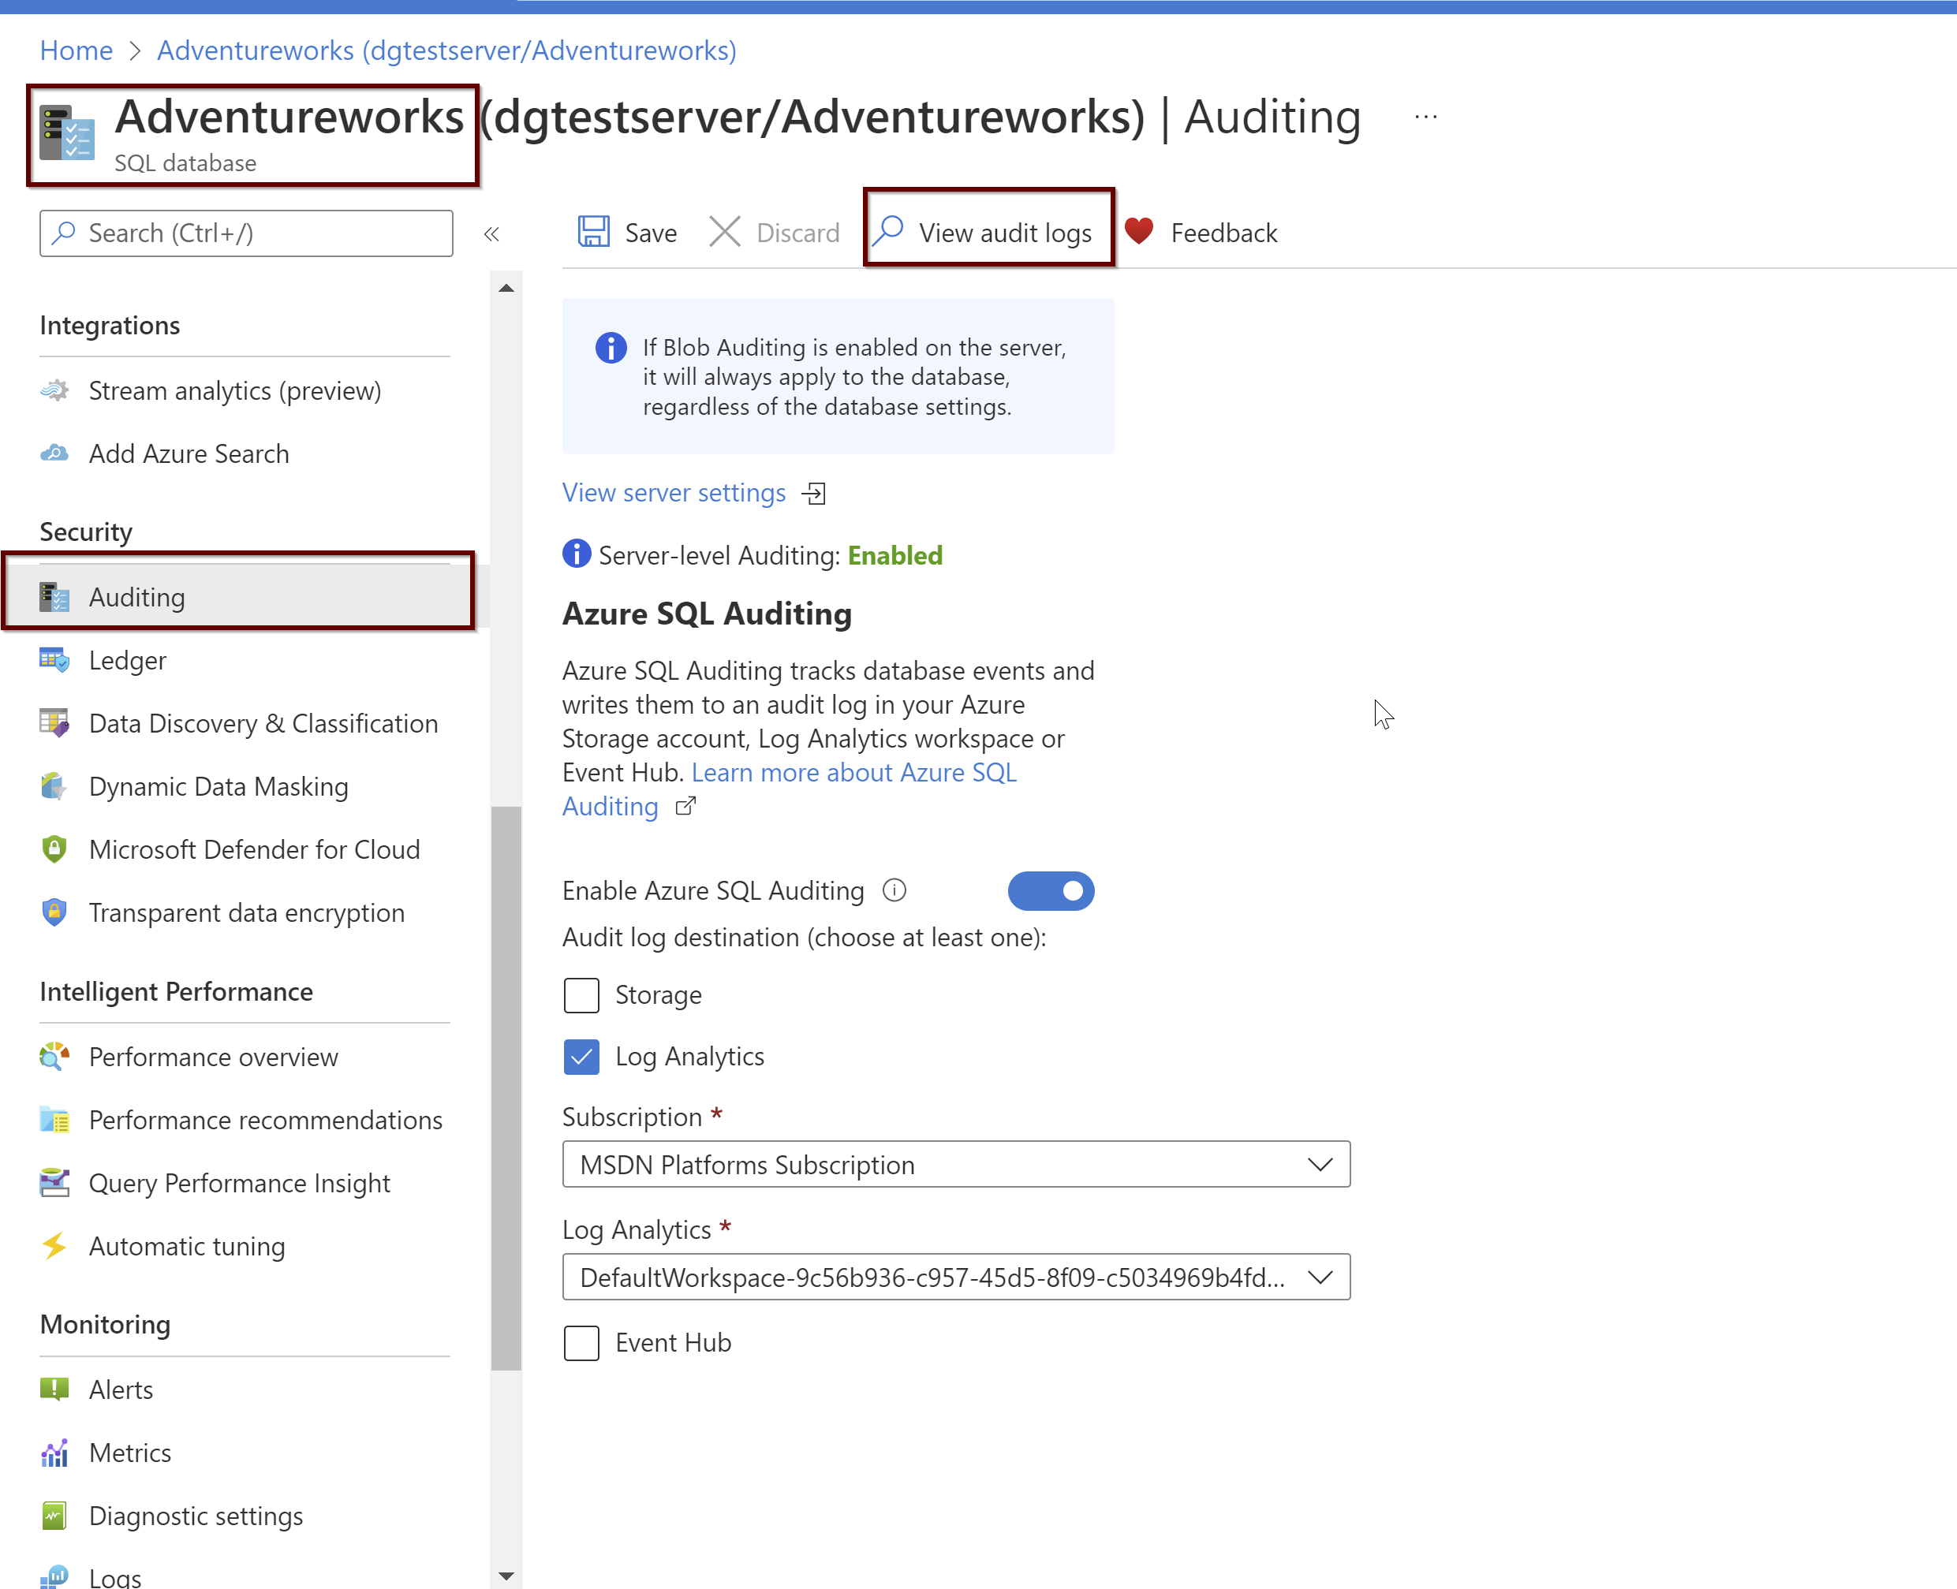

Slide 52
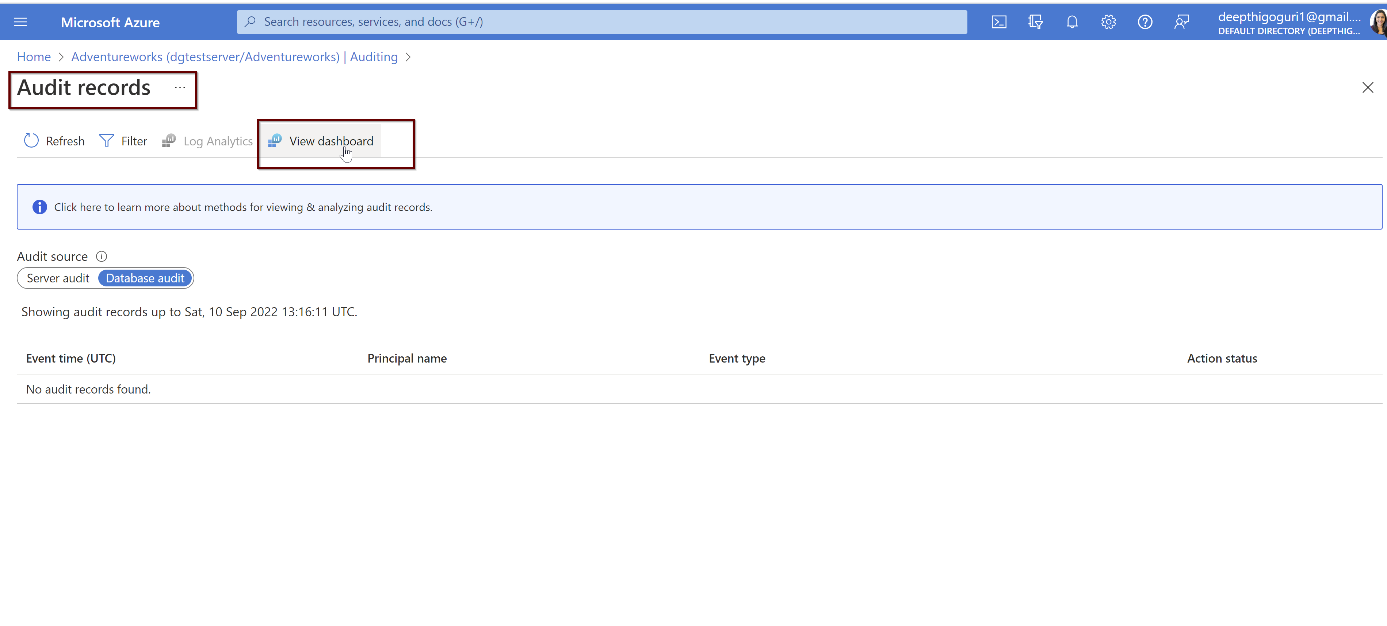

Slide 53
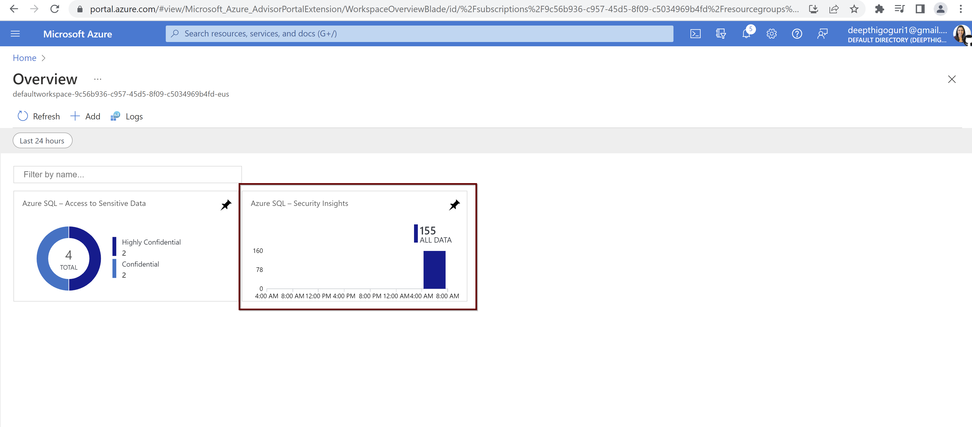

Slide 54
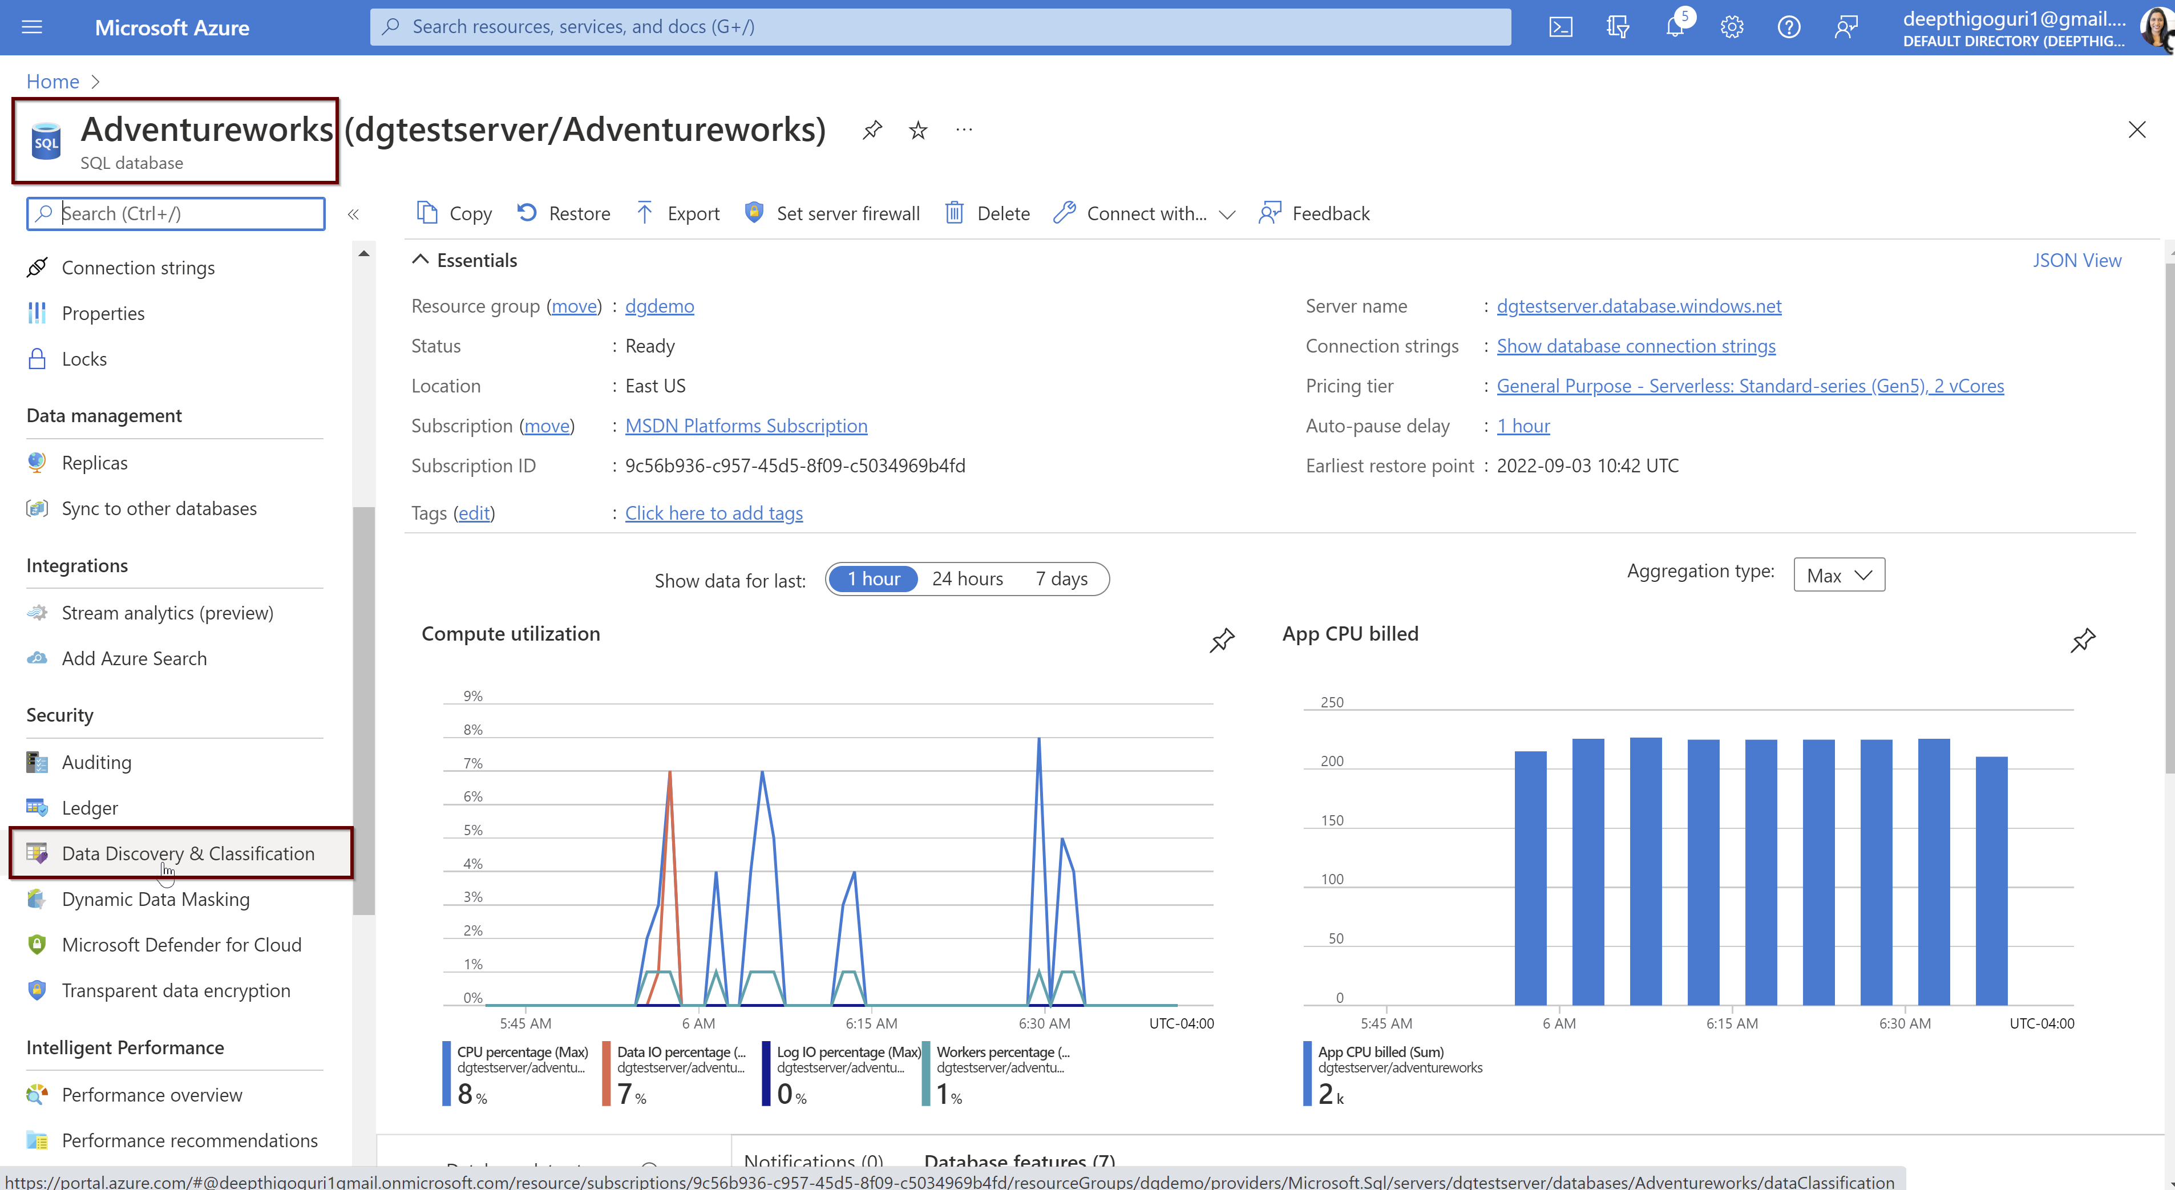
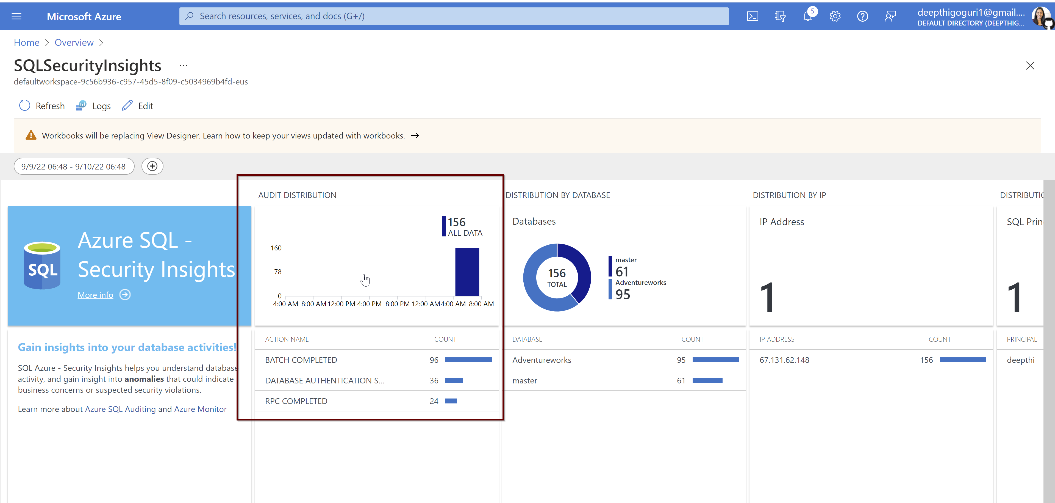

Slide 55
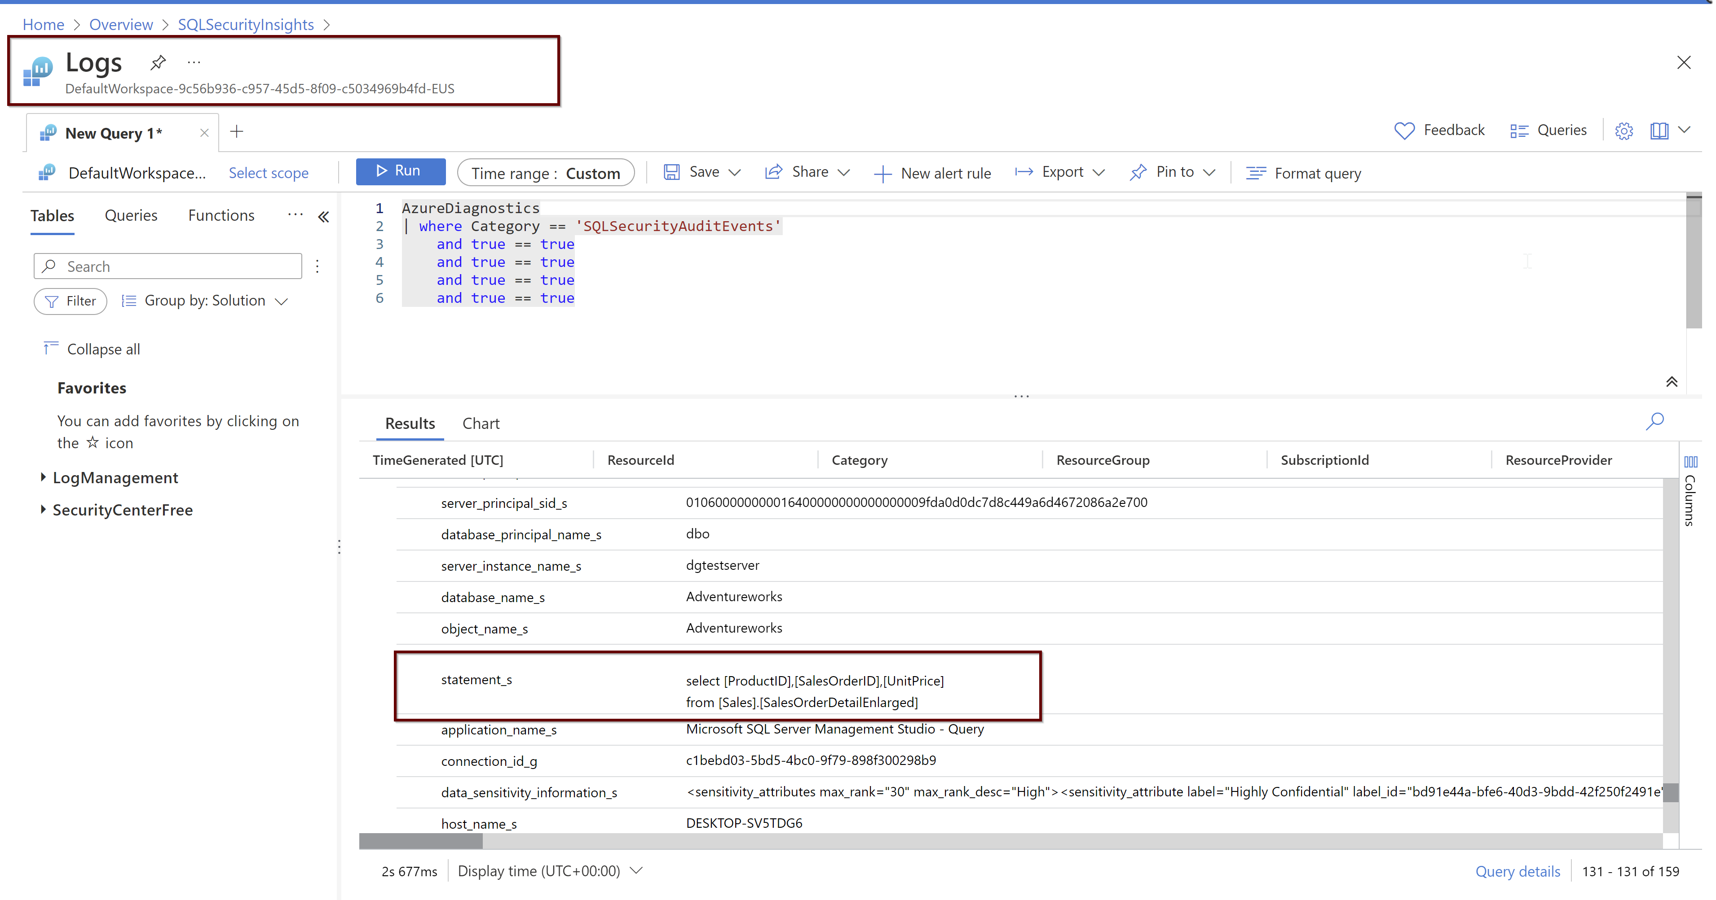

Slide 56
Data Governance - Data Classification

Slide 57
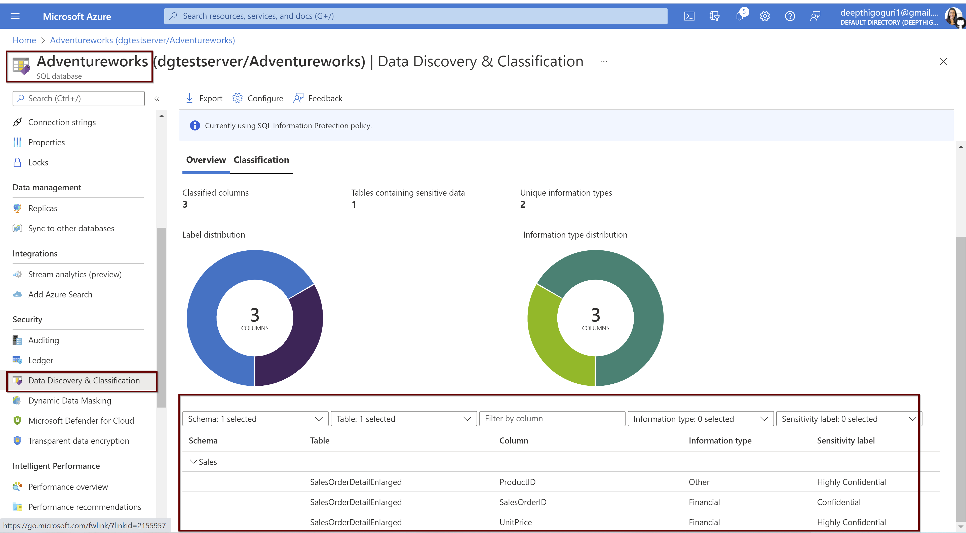

Slide 58
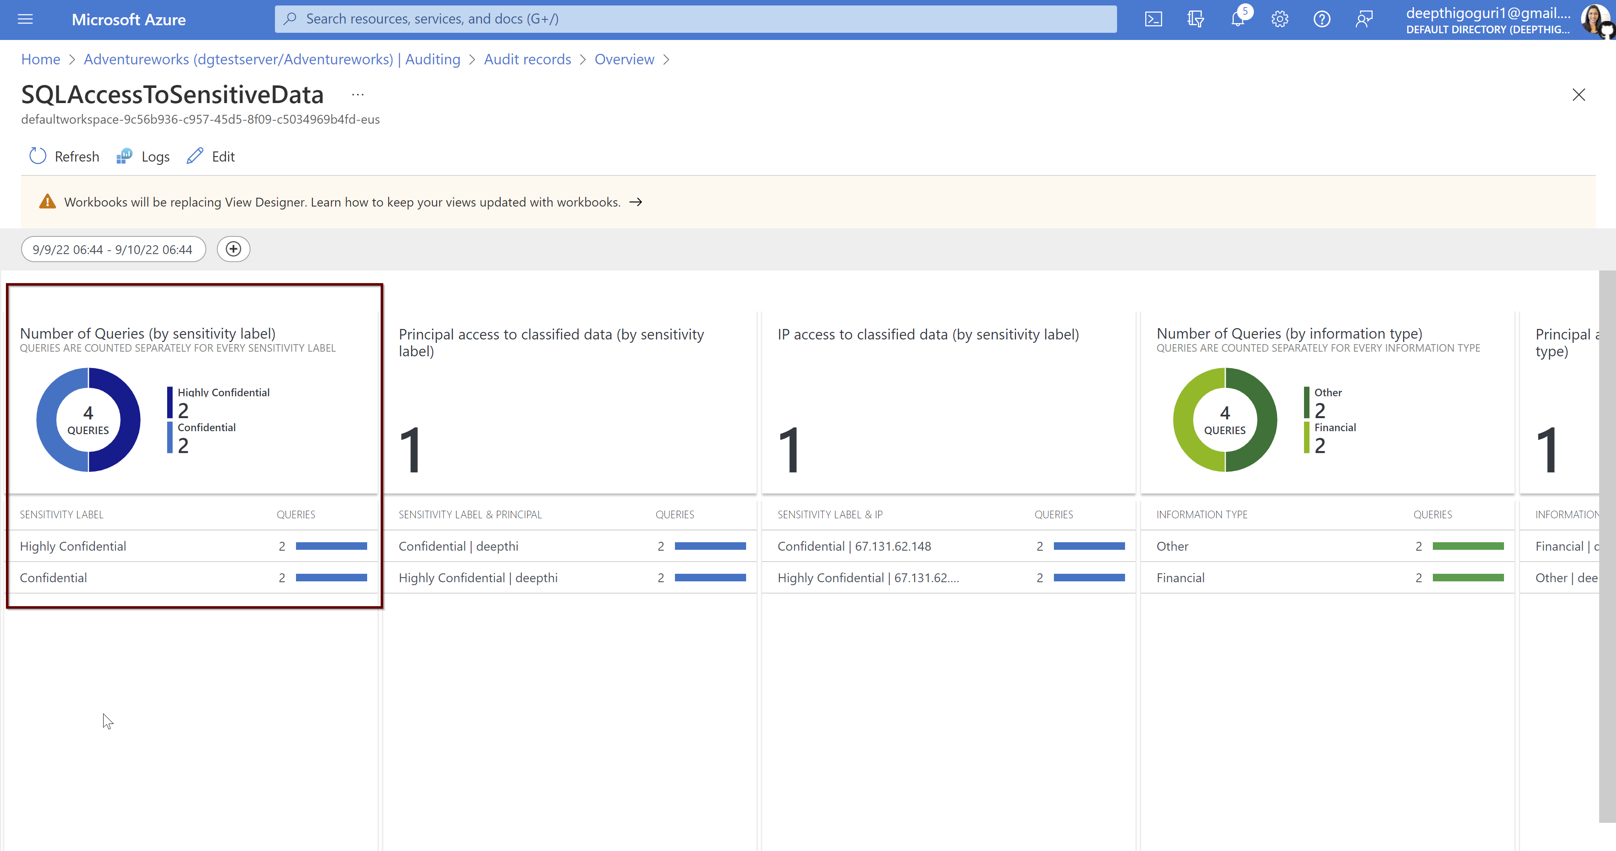

Slide 59
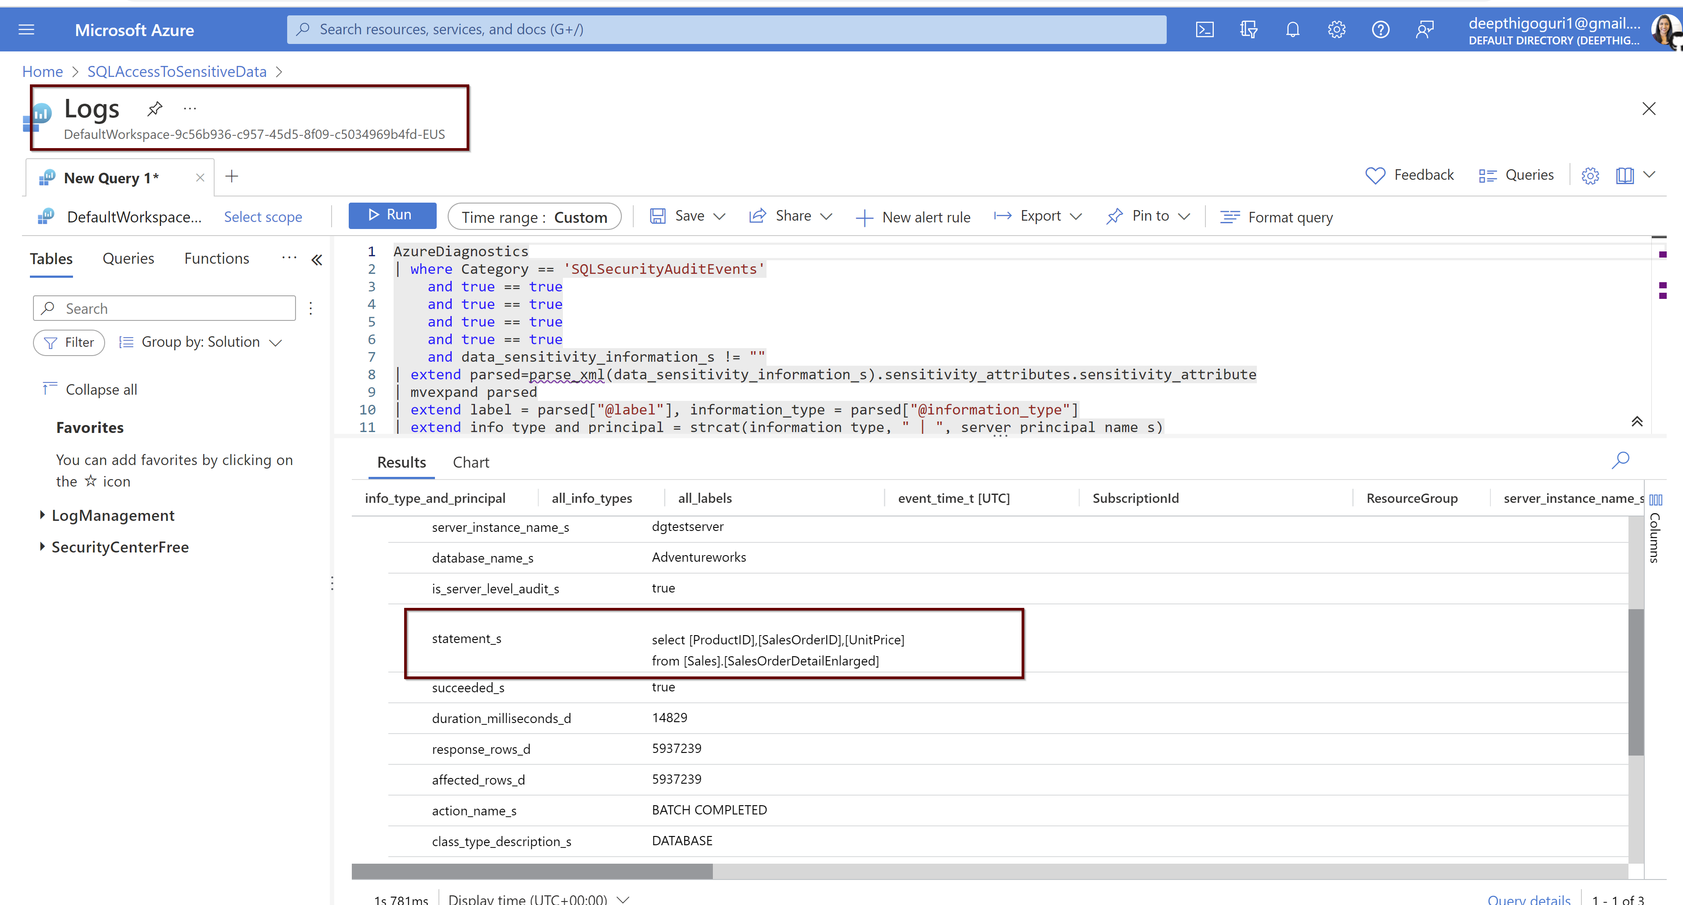

Slide 60
Resources
https://www.youtube.com/watch?v=g-ErYzXWq9Q&list=PL3EZ3A8mHh0yKcDQHylQfI5BT_mM1KY8Z&index=2
https://www.youtube.com/watch?v=XuoJwjOZPZw&list=PL3EZ3A8mHh0yKcDQHylQfI5BT_mM1KY8Z&index=3
https://www.youtube.com/watch?v=hZH3jHY-830
https://docs.microsoft.com/en-us/training/modules/azure-sql-secure-data/

Slide 61
Thank you!

